Slide 1

a glance at reinforcement learning
Adam Green adgefficiency.com
adam.green@adgefficiency.com

Slide 2
Today
one background & terminology
two introduction to reinforcement learning
three value functions
four policy gradients
five AlphaGo & AlphaGo Zero
six practical concerns
seven beyond the expectation & inverse RL

Slide 3

Introduction
B.Eng Chemical & Process Engineering
MSc Advanced Process Design for Energy
Four years as an Energy Engineer at ENGIE
Early 2017 three month bootcamp at Data Science Retreat in Berlin
now teach this reinforcement learning course there
Now at Tempus Energy
energy startup
decarbonize the grid through flexibility
supervised learning to predict electricity prices
reinforcement learning to control flexibility assets

Slide 4
Motivations for today
learning (for me as well!)
getting you excited about the field
seeing the concepts are within reach
knowing where to look next

Slide 5
one
nomenclature & definitions
background & terminology

Slide 6
Where to start
Sutton & Barto – Reinforcement Learning: An Introduction
the bible of reinforcement learning
RL Course by David Silver
10 lecture series by lead DeepMind programmer
Li (2017) Deep Reinforcement Learning: An Overview
These are all in the course repo https://github.com/ADGEfficiency/DSR_RL

Slide 7
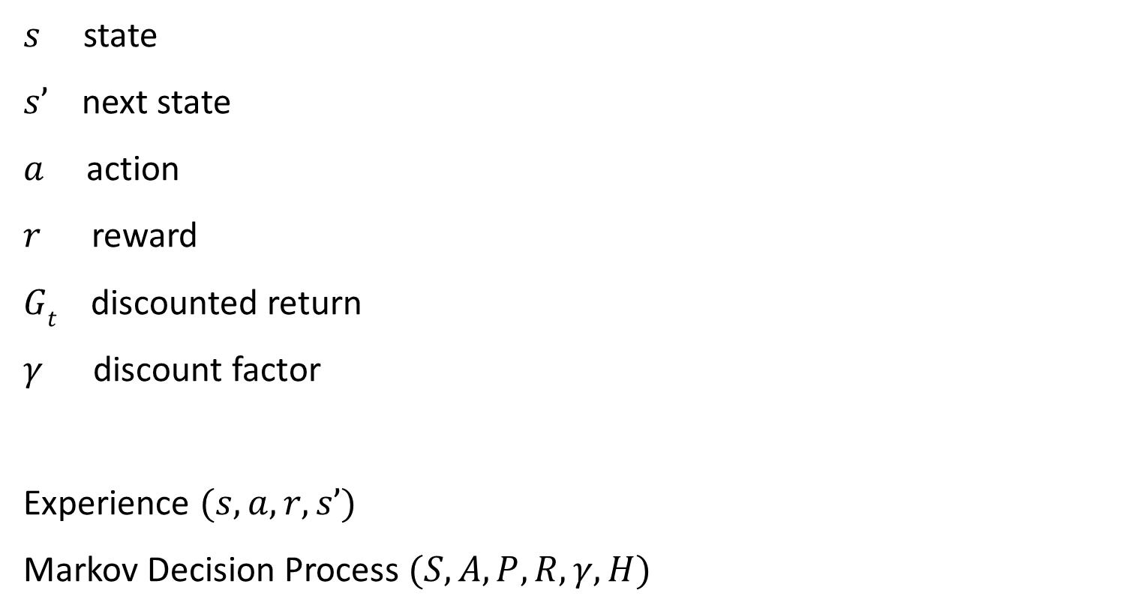
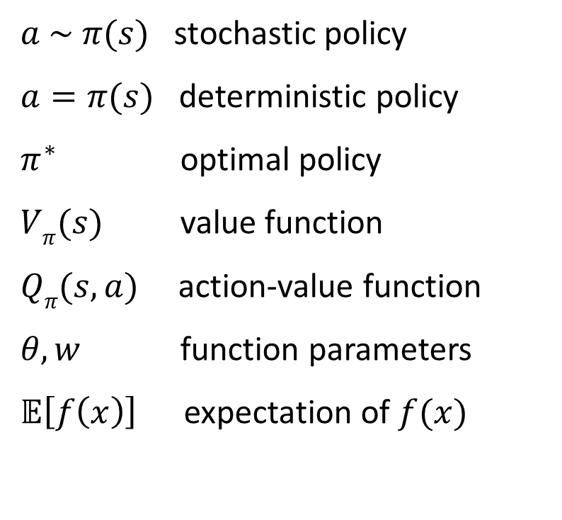
Nomenclature
$s$ state
$s’$next state
$a$ action
$r$ reward
$Gt$ discounted return
$γ$ discount factor
Experience $(s, a, r, s’)$
Markov Decision Process $(S, A, P, R, γ, H)$
$a \sim π(s)$ stochastic policy
$a=π(s)$ deterministic policy
$π^{∗}$ optimal policy
$Vπ(s)$ value function
$Qπ(s, a)$action-value function
$θ, w$ function parameters
$𝔼\left[f\left(x\right)\right]$expectation of $f(x)$

Slide 8
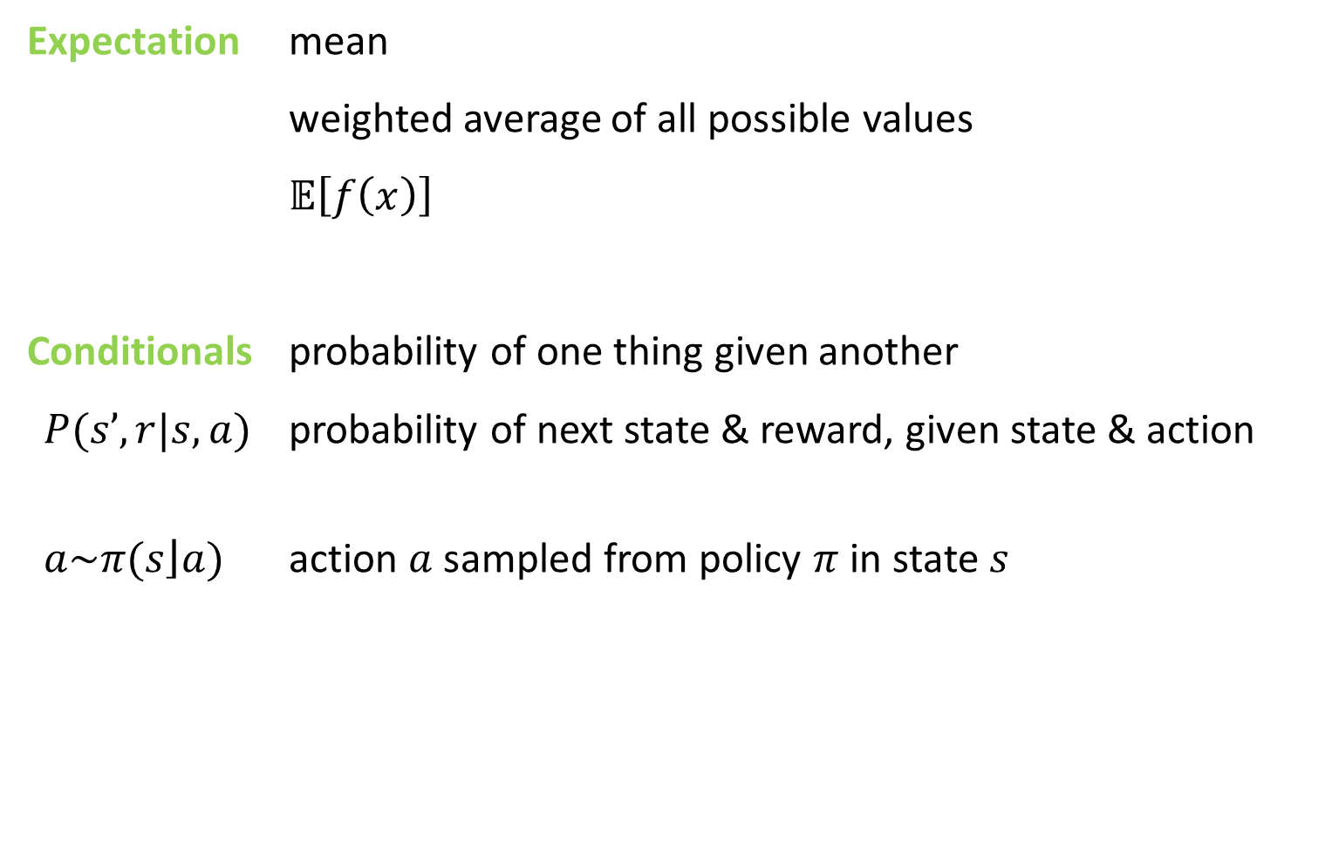
Definitions
Expectation mean
weighted average of all possible values
$𝔼\left[f\left(x\right)\right]$
Conditionals probability of one thing given another
$P(s’, r|s,a)$ probability of next state & reward, given state & action
$a\sim π(\left.s\right\rfloor a)$ action $a$ sampled from policy $π$ in state $s$

Slide 9
Variance & bias in supervised learning
Model generalization error = bias + variance + noise
Variance
error from sensitivity to noise in data set
model sees patterns that aren’t there -> overfitting
Bias
error from assumptions in the learning algorithm
model can miss relevant patterns -> underfitting

Slide 10
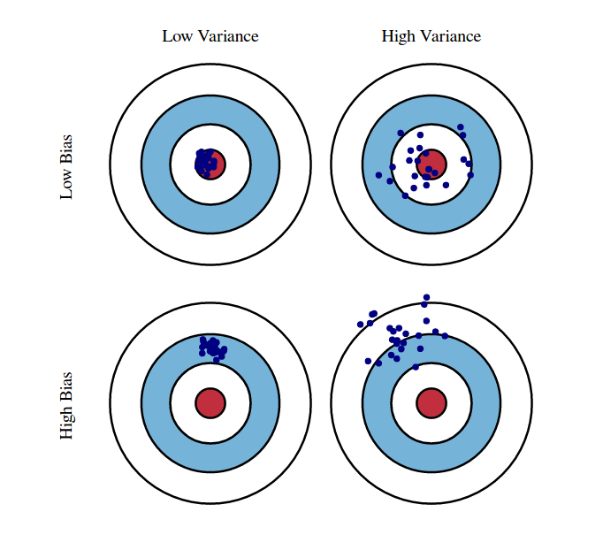
Variance & bias in reinforcement learning
Variance
deviation from expected value
how consistent is my model / sampling
can often be dealt with by sampling more
Bias
expected deviation vs true value
how close to the truth is my model
approximations or bootstrapping tend to introduce bias

Slide 11
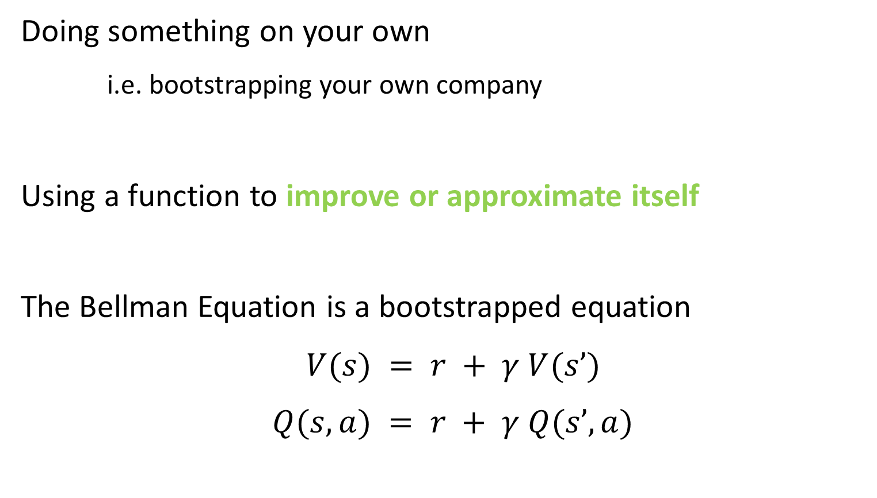
Bootstrapping
Doing something on your own
i.e. bootstrapping your own company
Using a function to improve or approximate itself
The Bellman Equation is a bootstrapped equation
$V(s) = r + γ V(s’)$
$Q(s,a) = r + γ Q(s’,a)$

Slide 12
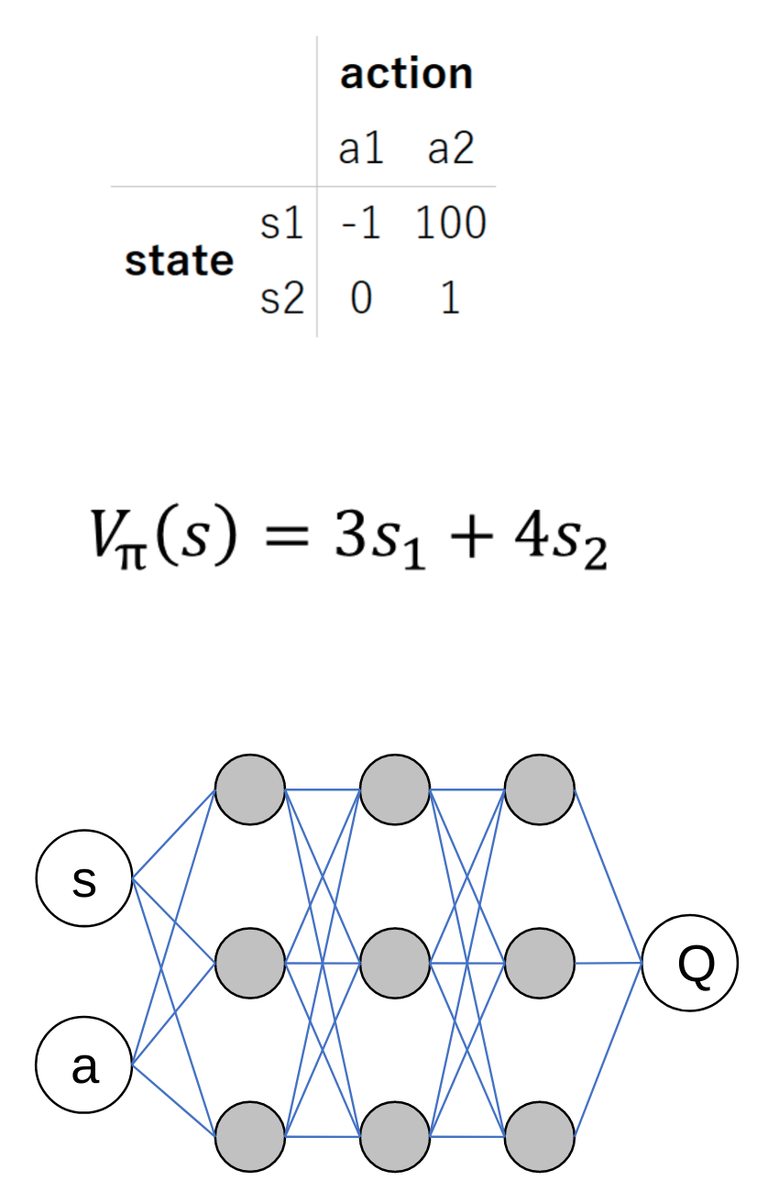
Function approximation
Lookup table
curse of dimensionality
Linear function
less parameters
generalize across states
Non-linear function
model complex dynamics
convolution for vision
recurrency for memory

Slide 13
iid
Fundamental assumption in statistical learning
independent and identically distributed
In statistical learning one always assumes the training set is independently drawn from a fixed distribution

Slide 14
two
introduction to reinforcement learning

Slide 15
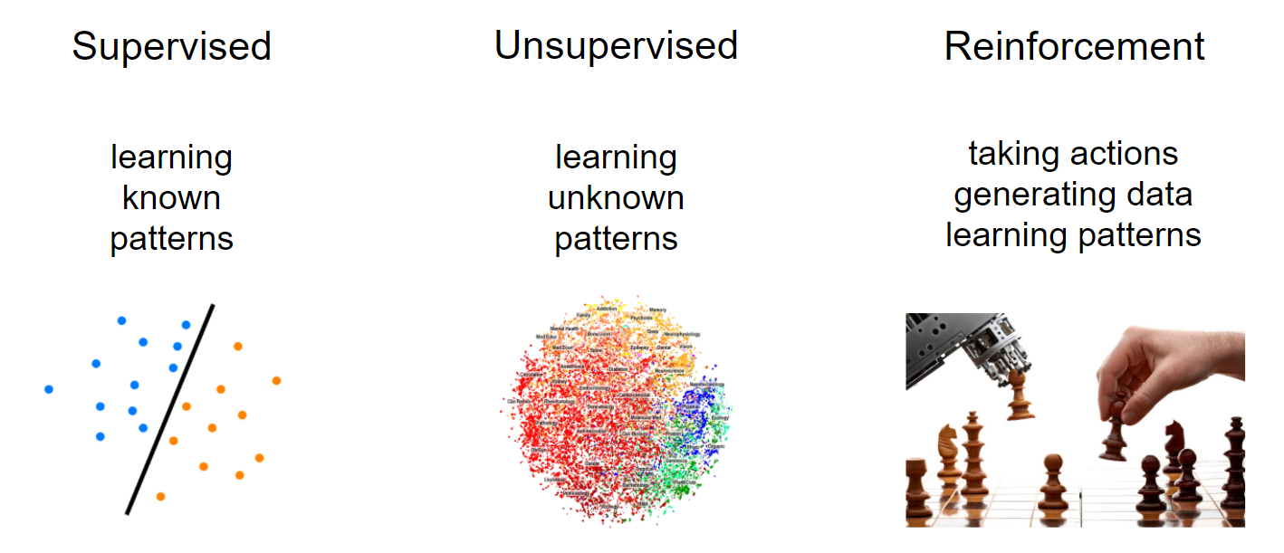
Machine learning

Slide 16
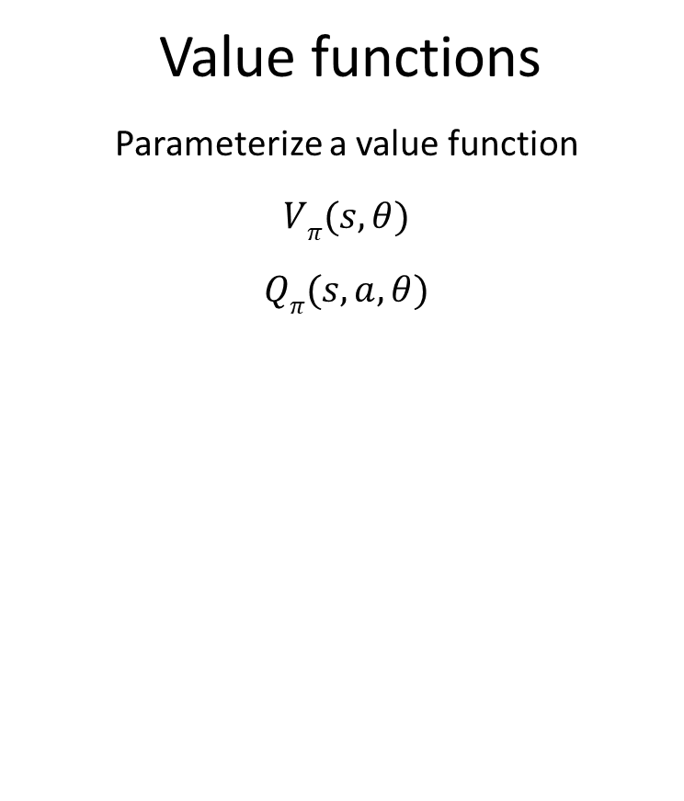
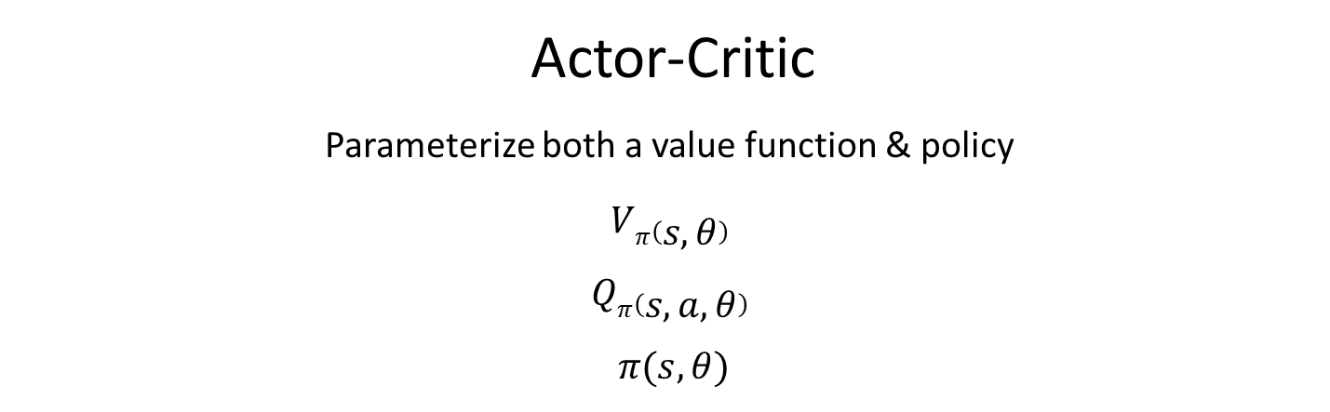
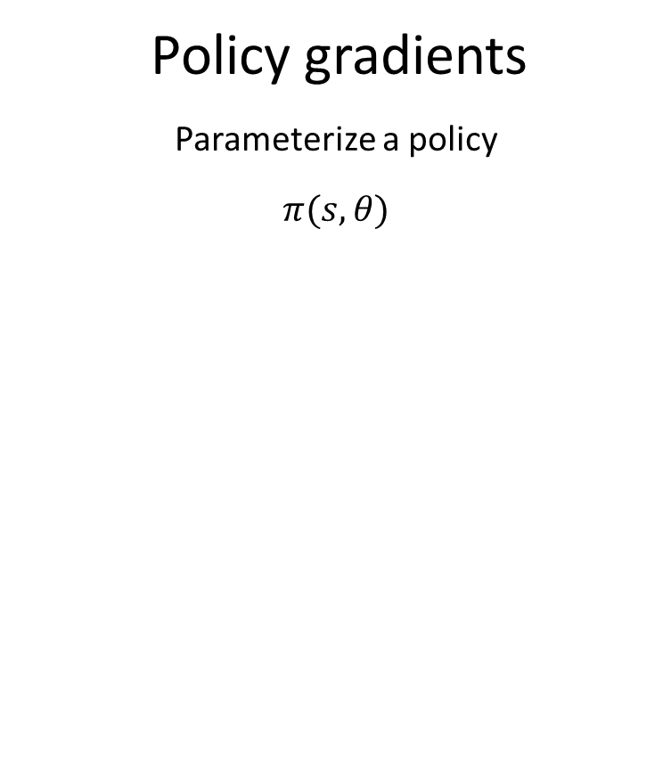
Reinforcement learning
Value functions
Parameterize a value function
$Vπ(s, θ)$
$Qπ(s, a, θ)$
Policy gradients
Parameterize a policy
$π(s, θ)$
Actor-Critic
Parameterize both a value function & policy
$Vπ\left(s, θ\right)$
$Qπ\left(s, a, θ\right)$
$π(s, θ)$

Slide 17
Applications
robotics
self driving cars
smart contracts on blockchains
recommender systems
neural network design
manufacturing
energy
= decision making

Slide 18
Reinforcement learning is not
NOT an alternative method to use instead of a random forest, neural network etc
“I’ll try to solve this problem using a convolutional nn or RL” this is nonsensical
Neural networks (supervised techniques in general) are a tool that reinforcement learners can use

Slide 19
Deep reinforcement learning
Deep learning
neural networks with multiple layers
Deep reinforcement learning
using multiple layer networks to approximate policies or value functions
Feedforward, convolutional or recurrent neural networks for the approximation

Slide 20

A new level of intelligence
Demis Hassabis is Founder & CEO of DeepMind
the brilliance of AlphaGo in it’s 2015 series

Slide 21
Reinforcement learning is learning through action

Slide 22
learns to maximise return
AGENT
state,
reward
action
ENVIRONMENT
responds to action

Slide 23
Biological inspiration
Neurobiological evidence that reward signals during perceptual learning may influence the characteristics of representations within the primate visual cortex
Atari 2015 (ref 27, 28)
Psychological & neuroscientific perspectives of animal behaviour (ref 2/3 atair 2015)

Slide 24
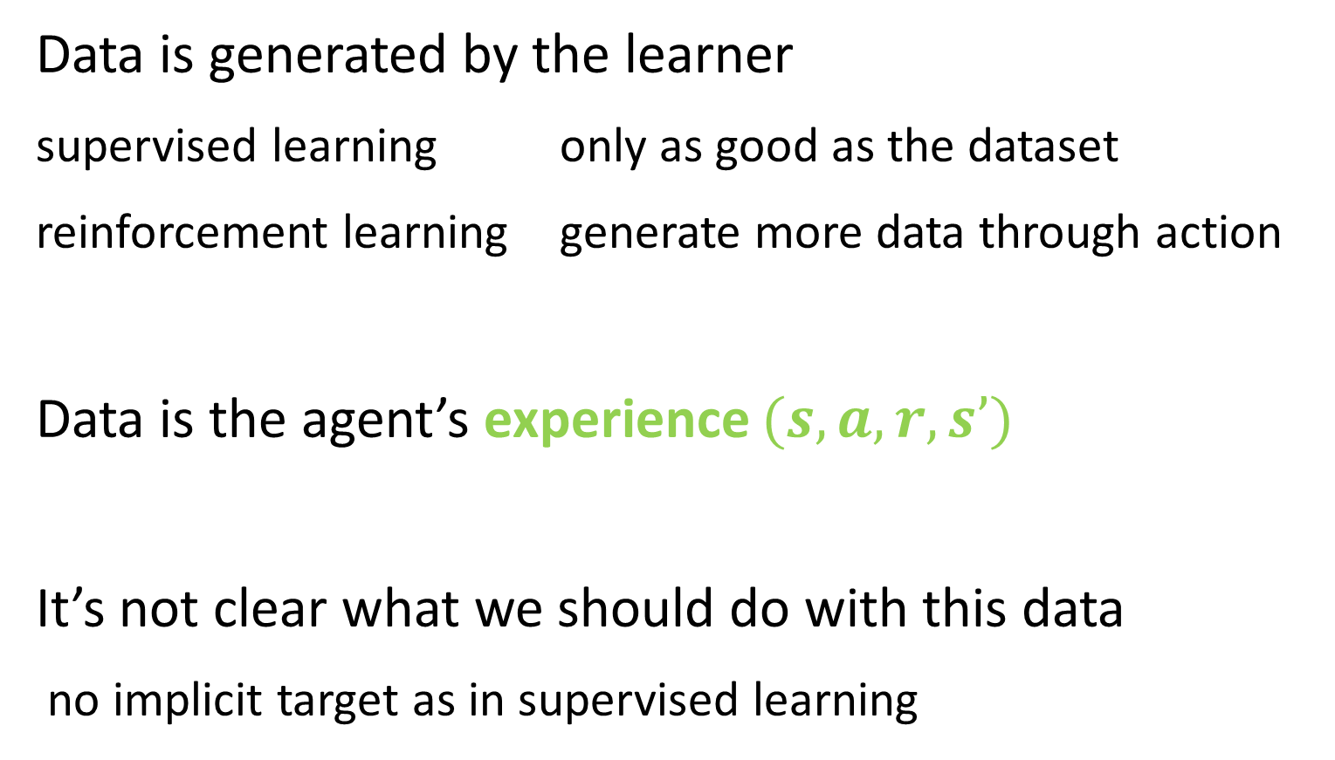
Data in reinforcement learning
Data is generated by the learner
supervised learning only as good as the dataset
reinforcement learning generate more data through action
Data is the agent’s experience $(s, a, r, s’)$
It’s not clear what we should do with this data
no implicit target as in supervised learning

Slide 25
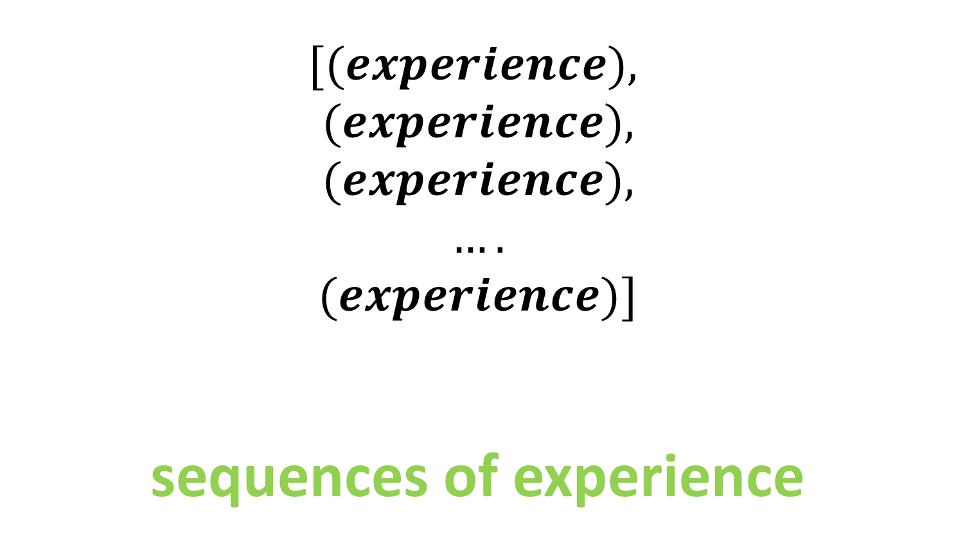
Reinforcement learning dataset
$$[(experience),$$
$$(experience),$$
$$(experience),$$
$$….$$
$$(experience)]$$
sequences of experience

Slide 26
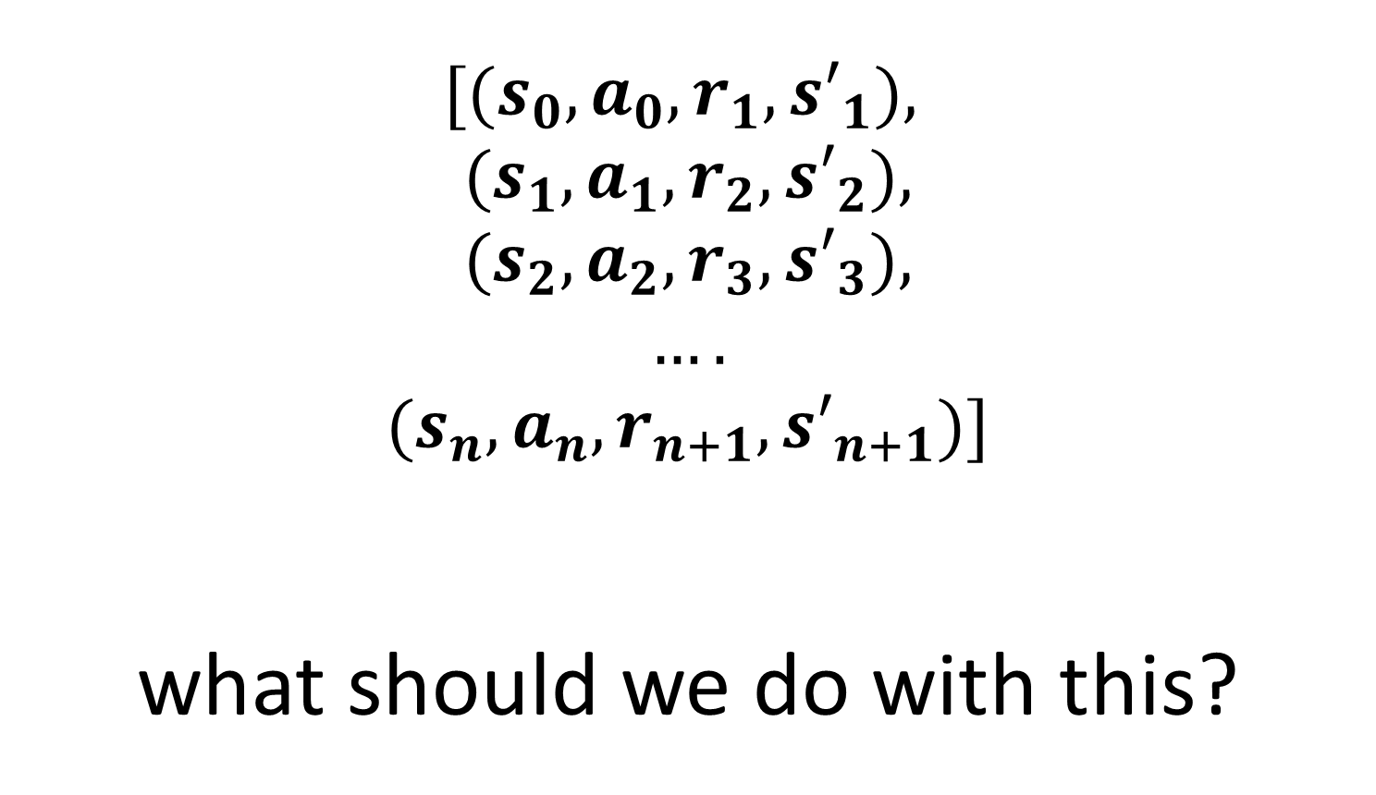
Reinforcement learning dataset
$$[(s_{0}, a_{0}, r_{1},{s′}_{1}),$$
$$(s_{1}, a_{1}, r_{2},{s′}_{2}),$$
$$(s_{2}, a_{2}, r_{3},{s′}_{3}),$$
$$….$$
$$(s_{n}, a_{n}, r_{n+1},{s′}_{n+1})]$$
what should we do with this?

Slide 27
Four challenges
one exploration vs exploitation
two data
three credit assignment
four sample efficiency

Slide 28
Exploration vs exploitation
Do I go to the restaurant in Berlin I think is best – or do I try something new?
Exploration = finding information
Exploitation = using information
How stationary are the environment state transition and reward functions? How stochastic is my policy?

Slide 29
Exploration vs exploitation
Design of reward signal vs exploration required
Algorithm does care about the time step
too small = rewards are delayed = credit assignment harder
exploration becomes more like a random walk

Slide 30
Data – correlated samples
All the samples collected on a given episode are correlated (along the state trajectory)
This breaks the iid assumption of independent sampling
Sequences of experiences are correlated – the sampling is not independent

Slide 31
Data – non-stationary distribution
Environment can be non-stationary
Learning changes the data we see
Exploration changes the data we see
All of these break the identically distributed assumption of iid

Slide 32
Reinforcement learning always breaks supervised learning assumptions about data quality

Slide 33
Credit assignment
Which actions give us which reward
Reward signal is often
delayed benefit of action only seen later
sparse experience may have a reward of 0
Sometimes we can design a more dense reward signal for a given environment

Slide 34
Sample efficiency
How quickly a learner learns
How often we reuse data
do we only learn once or can we learn from it again
on vs off policy
How much we squeeze out of data
i.e. learn a value function, learn a environment model

Slide 35
Four challenges
exploration vs exploitation
how good is my understanding of the range of options
data
biased sampling, non-stationary distribution
credit assignment
which action gave me this reward
sample efficiency
learning quickly, squeezing information from data

Slide 36
two
introduction to reinforcement learning
Markov Decision Processes

Slide 37
Markov Decision Processes
Mathematical framework for the reinforcement learning problem
A lot of theory (which we won’t cover today) proves that certain algorithms will converge to unbiased or optimal values in MDPs

Slide 38
Markov property
Can make prediction or decisions using only the current state
any additional information about the history of the process will not improve our decision
Present state is totally independent of the past
Future is conditional only on the present

Slide 39
State vs observation
Not all reinforcement learning problems are MDPs
it’s more of an ideal - often unrealistic in practice
Often we are limited to partially observed MDPs
POMDP
the agent can only see some of the state variables
Lose convergence guarantees
still might be able to train a good agent

Slide 40
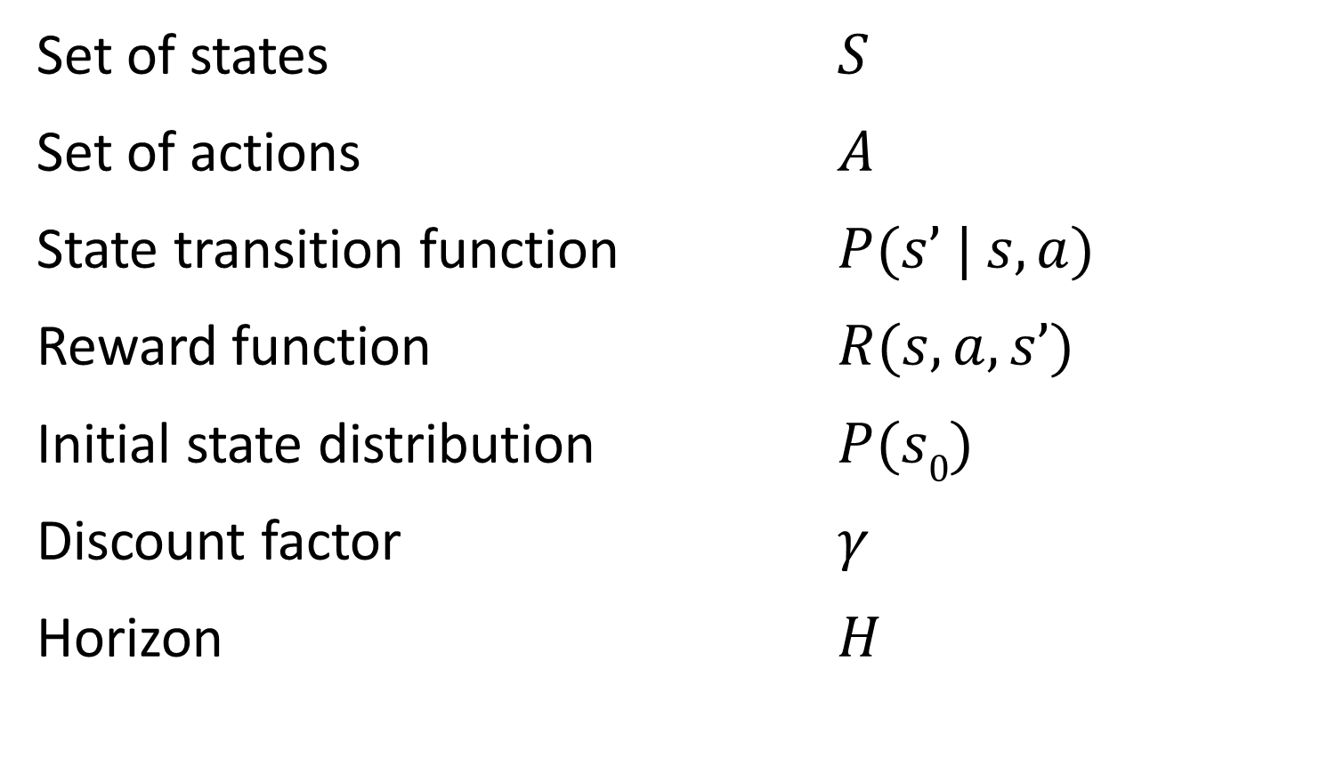
Formal definition of an MDP
Set of states $S$
Set of actions $A$
State transition function $P(s’ | s, a)$
Reward function $R(s, a, s’)$
Initial state distribution $P(s0)$
Discount factor $γ$
Horizon $H$

Slide 41
Informal definition of an MDP
Two objects
agent + environment
Three signals
state, action, reward
agent
state,
reward
action
environment

Slide 42
Environment
Real or virtual
Discrete or continuous
action space
state space
Episodic vs. non-episodic
agent
state,
reward
state,
reward
action
environment

Slide 43
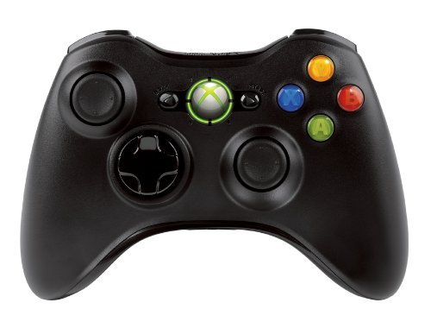
Discrete vs continuous spaces
Discrete action space
Continuous action space
Car accelerator from 0-100
We could discretize this as
[0, 1, 2, 3 … 99, 100]

Slide 44
Discrete vs continuous spaces
This can be a key consideration
some algorithms can only work with discrete spaces
Q-Learning requires a discrete action space to argmax across
Possible to discretize a continuous action space

Slide 45
Discretiziation
Too coarse
non-smooth control output
Too fine
curse of dimensionality
computationally expensive
Discretization requires some prior knowledge

Slide 46
State
Flexible concept
n-d array
Information for agent to
learn from
choose next action
Fully observed vs hidden
agent
state,
reward
action
environment

Slide 47
Reward
Flexible concept
scalar
delayed
sparse
agent
state,
reward
action
environment

Slide 48
Agent
Learner & decision maker
maximize cumulative discount reward
Agent always has a policy
even if it’s a bad one!
agent
state,
reward
action
environment

Slide 49

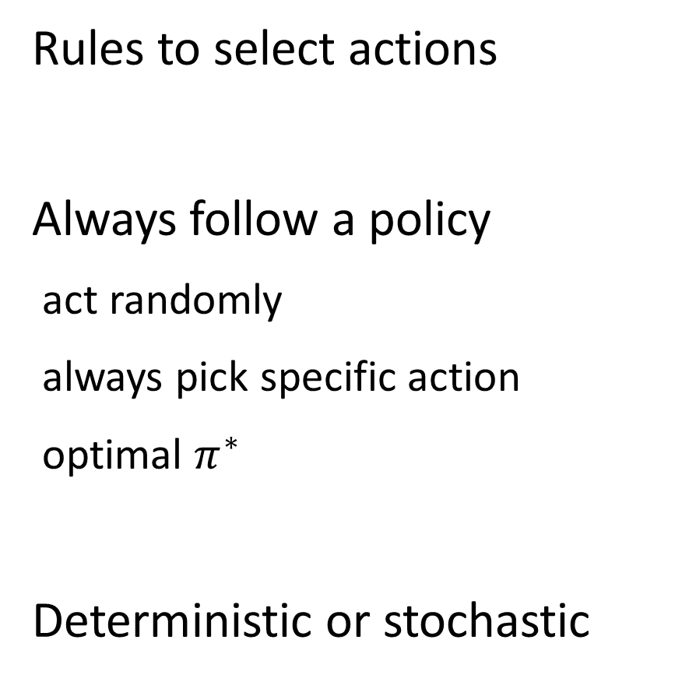
Policy - $π(s)$
Rules to select actions
Always follow a policy
act randomly
always pick specific action
optimal $π^{∗}$
Deterministic or stochastic
agent
state,
reward
action
environment

Slide 50

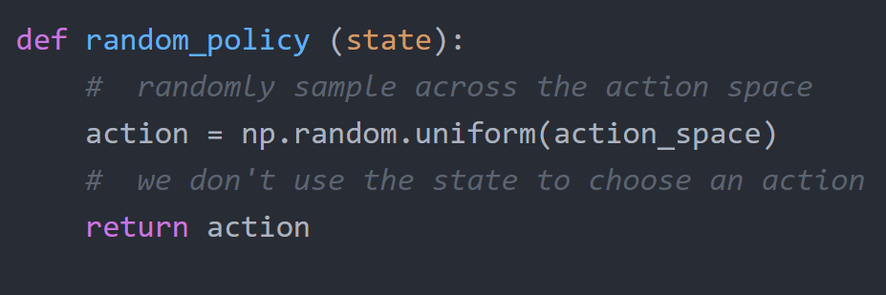

Random policy - $π(s)$

Slide 51
Policy - $π(s)$
On vs off policy learning
ability to learn from the experience of other policies
Policy can be
parameterized directly
generated from a value function
agent
state,
reward
action
environment

Slide 52
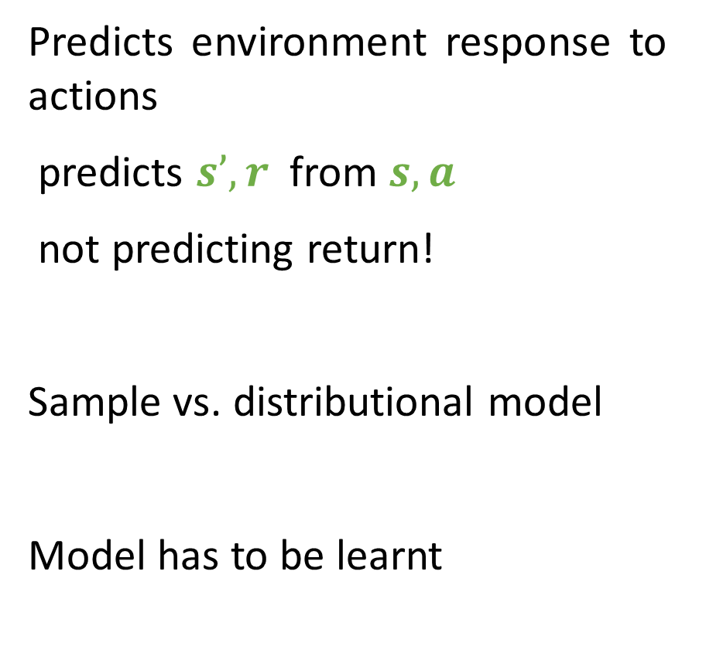
Environment model
Predicts environment response to actions
predicts $s’, r$from $s, a$
not predicting return!
Sample vs. distributional model
Model has to be learnt
agent
state,
reward
action
environment

Slide 53
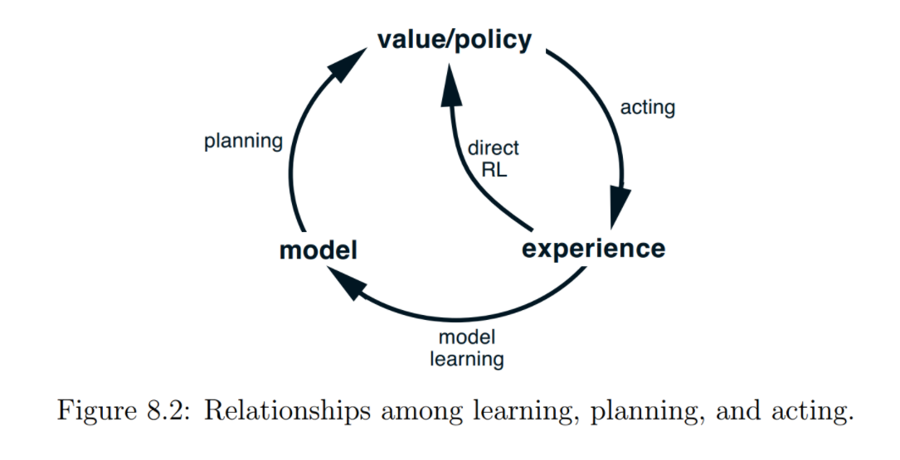
Sutton & Barto

Slide 54
learns to maximise return
AGENT
policy π(s)
value function(s) V_{π}(s), Q_{π}(s, a)
environment model(s)
state s,
reward r
action a
ENVIRONMENT
state transition P(s’ | s, a)
reward transition R(s, a, s’)
responds to action

Slide 55
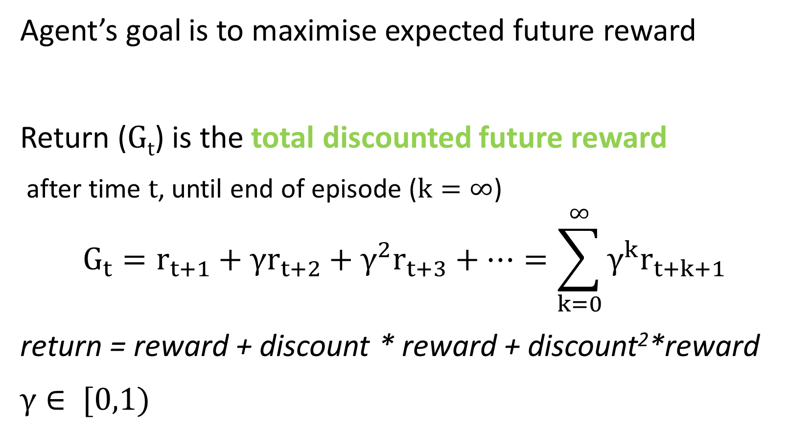
Return
Agent’s goal is to maximise expected future reward
Return (G_{t}) is the total discounted future reward
after time t, until end of episode ($k=∞$)
$$G_{t}=r_{t+1}+γr_{t+2}+γ^{2}r_{t+3}+…=\sum_{k=0}^{∞}{γ^{k}r_{t+k+1}}$$
return = reward + discount * reward + discount²*reward
$γ∈ [0,1)$

Slide 56
Why are we discounting?

Slide 57
Discounting
Future is uncertain
stochastic environment
Matches human thinking
hyperbolic discounting
Finance
time value of money
Makes return a geometric series
an infinite series with a finite sum

Slide 58
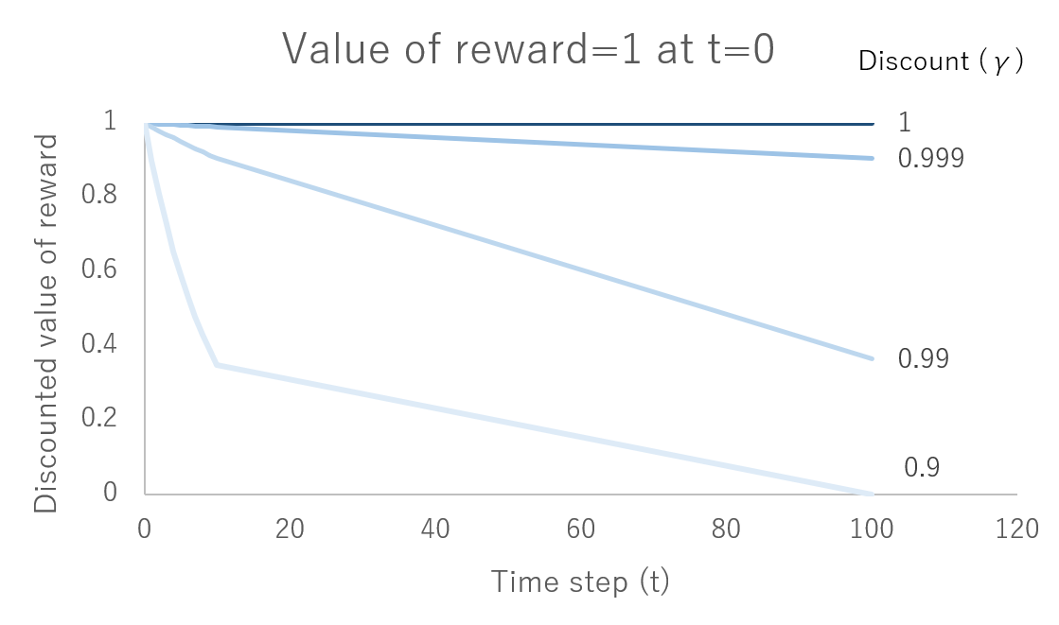
How much is a reward of 1 worth after t time steps

Slide 59
break

Slide 60
recap
Two objects agent & environment
Three signals state, reward & action
Policy rules to select actions
Environment model predicts next state & reward
Return future discounted reward

Slide 61
three - value function methods
introduction to value functions
Bellman equation

Slide 62
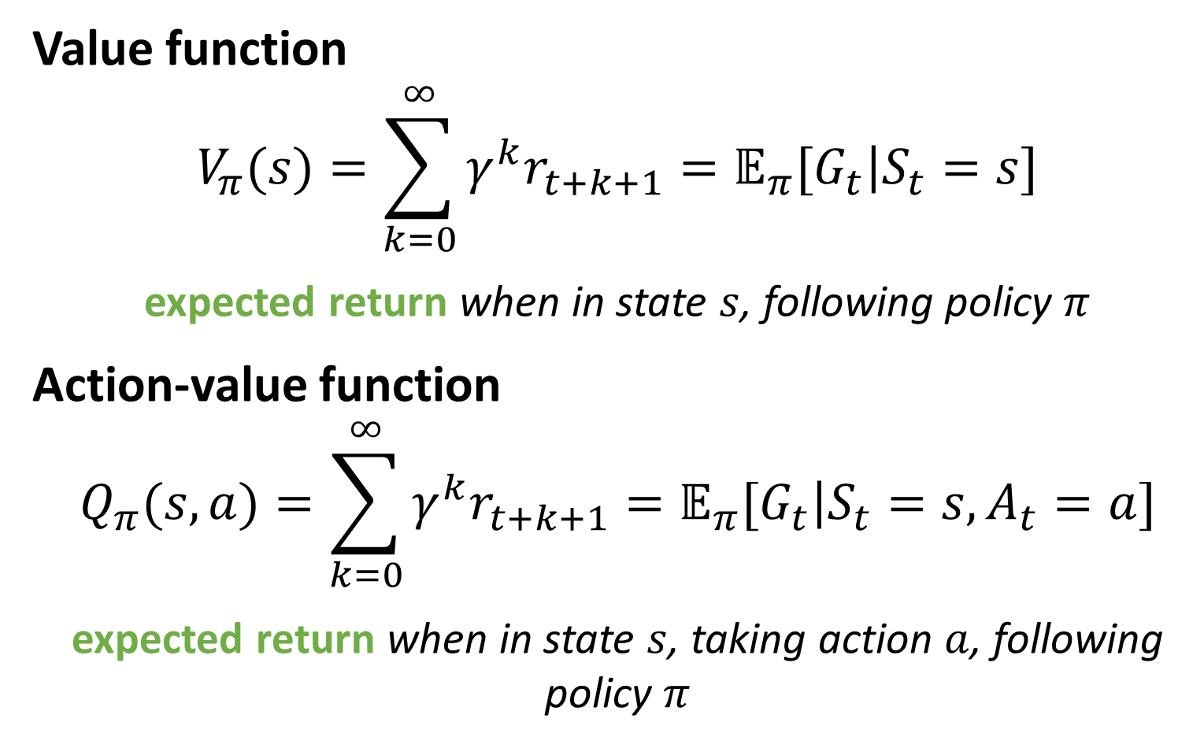
Value functions
Value function
$$V_{π}(s)=\sum_{k=0}^{∞}{γ^{k}r_{t+k+1}=𝔼_{π}[\left.G_{t}\right|S_{t}=s]}$$
expected return when in state $s$, following policy $π$
Action-value function
$$Q_{π}(s,a)=\sum_{k=0}^{∞}{γ^{k}r_{t+k+1}}=𝔼_{π}[\left.G_{t}\right|S_{t}=s,A_{t}=a]$$
expected return when in state $s$, taking action $a$, following policy $π$

Slide 63
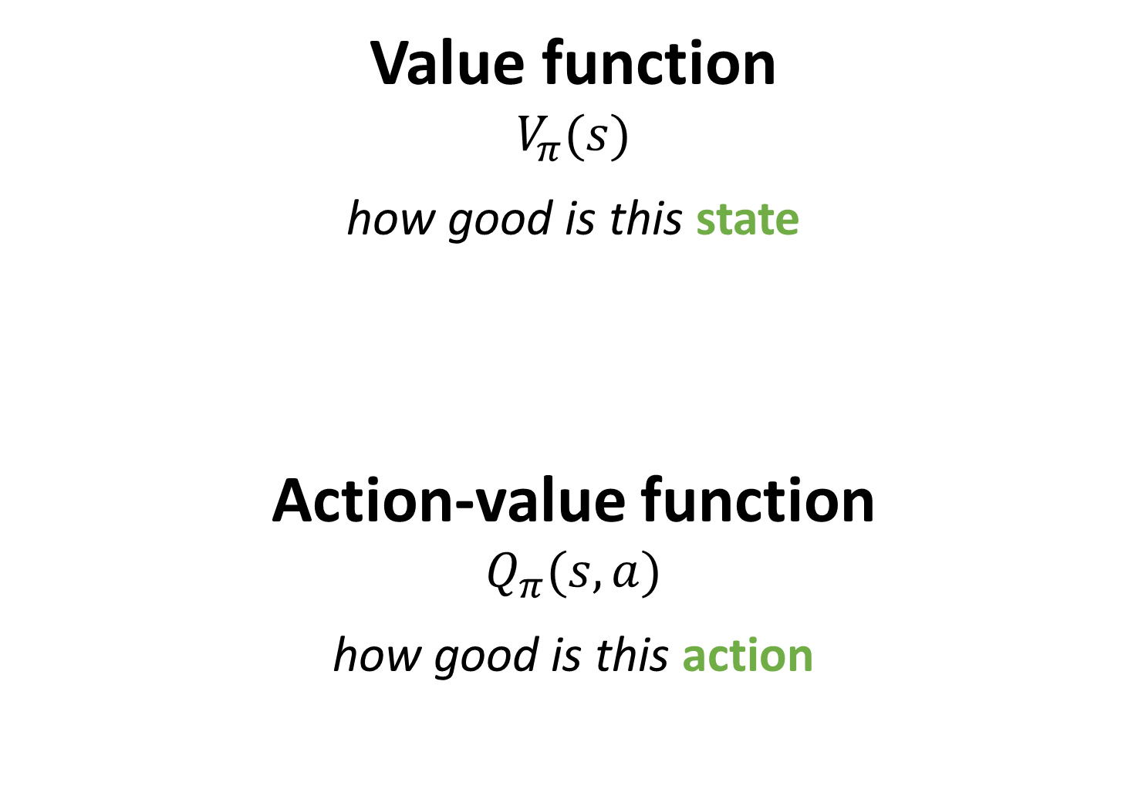
Value function
$$V_{π}(s)$$
how good is this state
Action-value function
$$Q_{π}(s,a)$$
how good is this action

Slide 64
Value functions
The value function is a prediction of the future
prediction of return – which is what our agent wants to maximize
always conditioned on a policy
But we don’t know this function
agent must learn it
once we learn it – how will it help us to act?

Slide 65
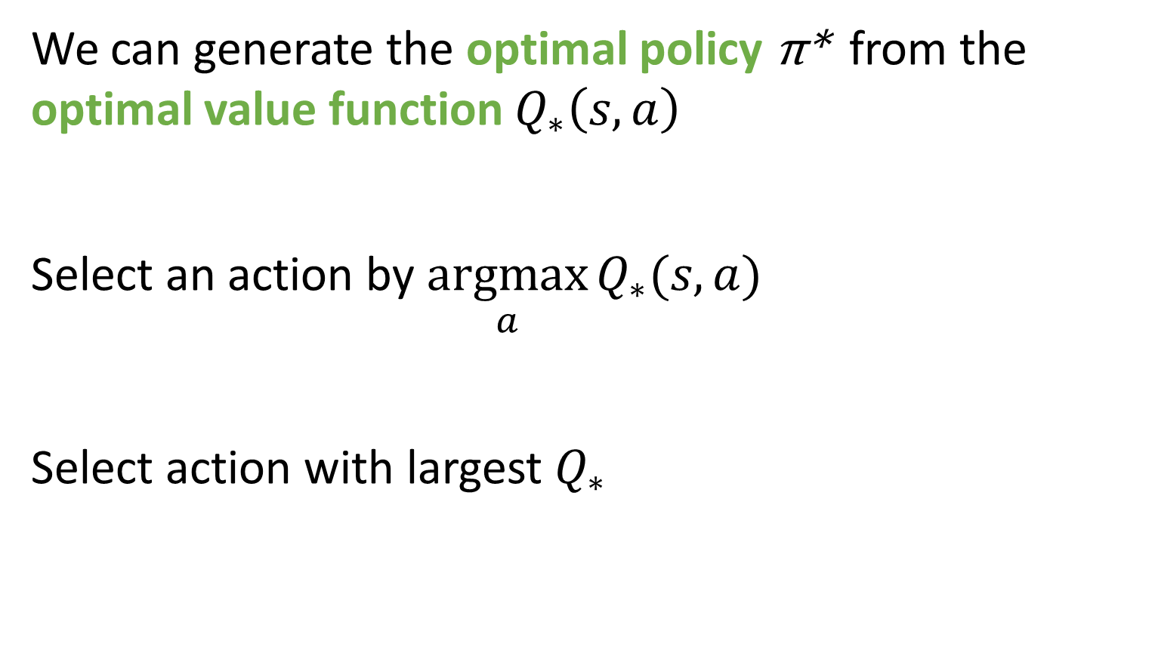
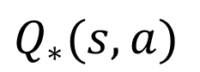
Generating a policy from a value function
We can generate the optimal policy π* from the optimal value function $Q_{∗}\left(s,a\right)$
Select an action by $\underset{a}{argmax}{Q_{∗}(s,a)}$
Select action with largest $Q_{∗}$
s
a₁
a₂
a₃
$$Q_{∗}(s,a)$$
3
4
5

Slide 66
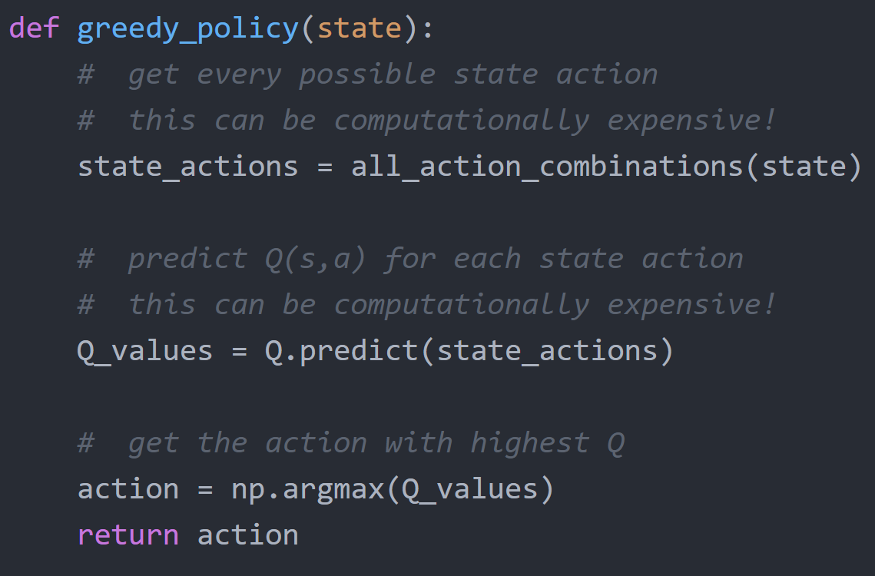

Greedy policy - $π(s)$

Slide 67
Value function approximation
Lookup table
curse of dimensionality
Linear function
less parameters
generalize across states
Non-linear function
model complex dynamics
convolution for vision
recurrent for memory

Slide 68

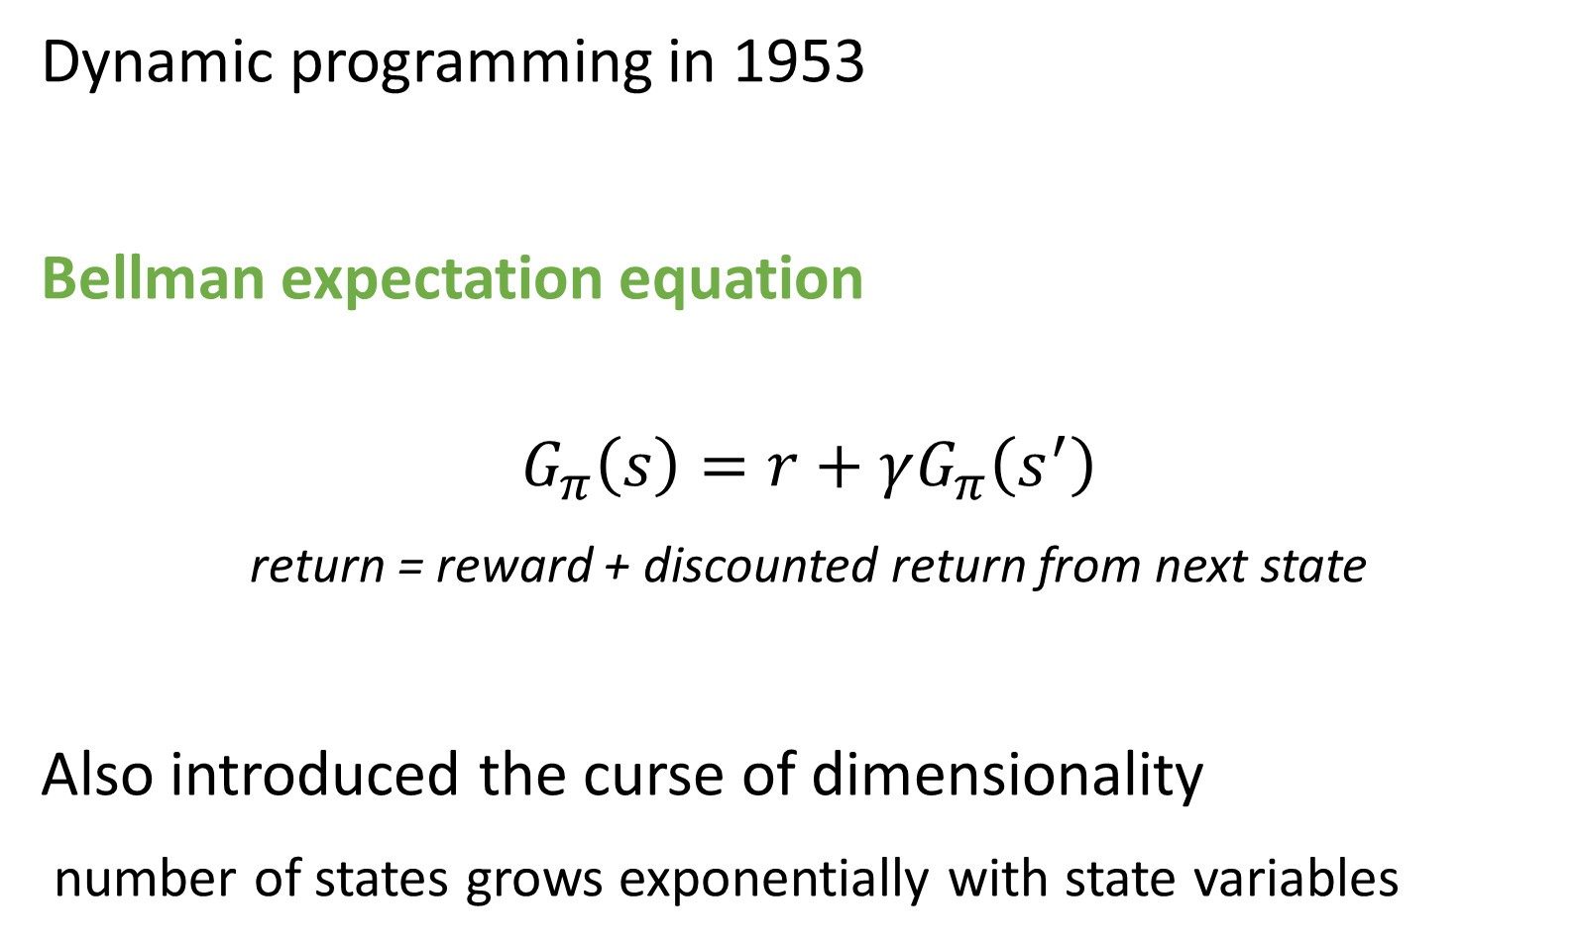
Richard Bellman
Dynamic programming in 1953
Bellman expectation equation
$$G_{π}\left(s\right)=r+γG_{π}\left(s^{′}\right)$$
return = reward + discounted return from next state
Also introduced the curse of dimensionality
number of states grows exponentially with state variables

Slide 69
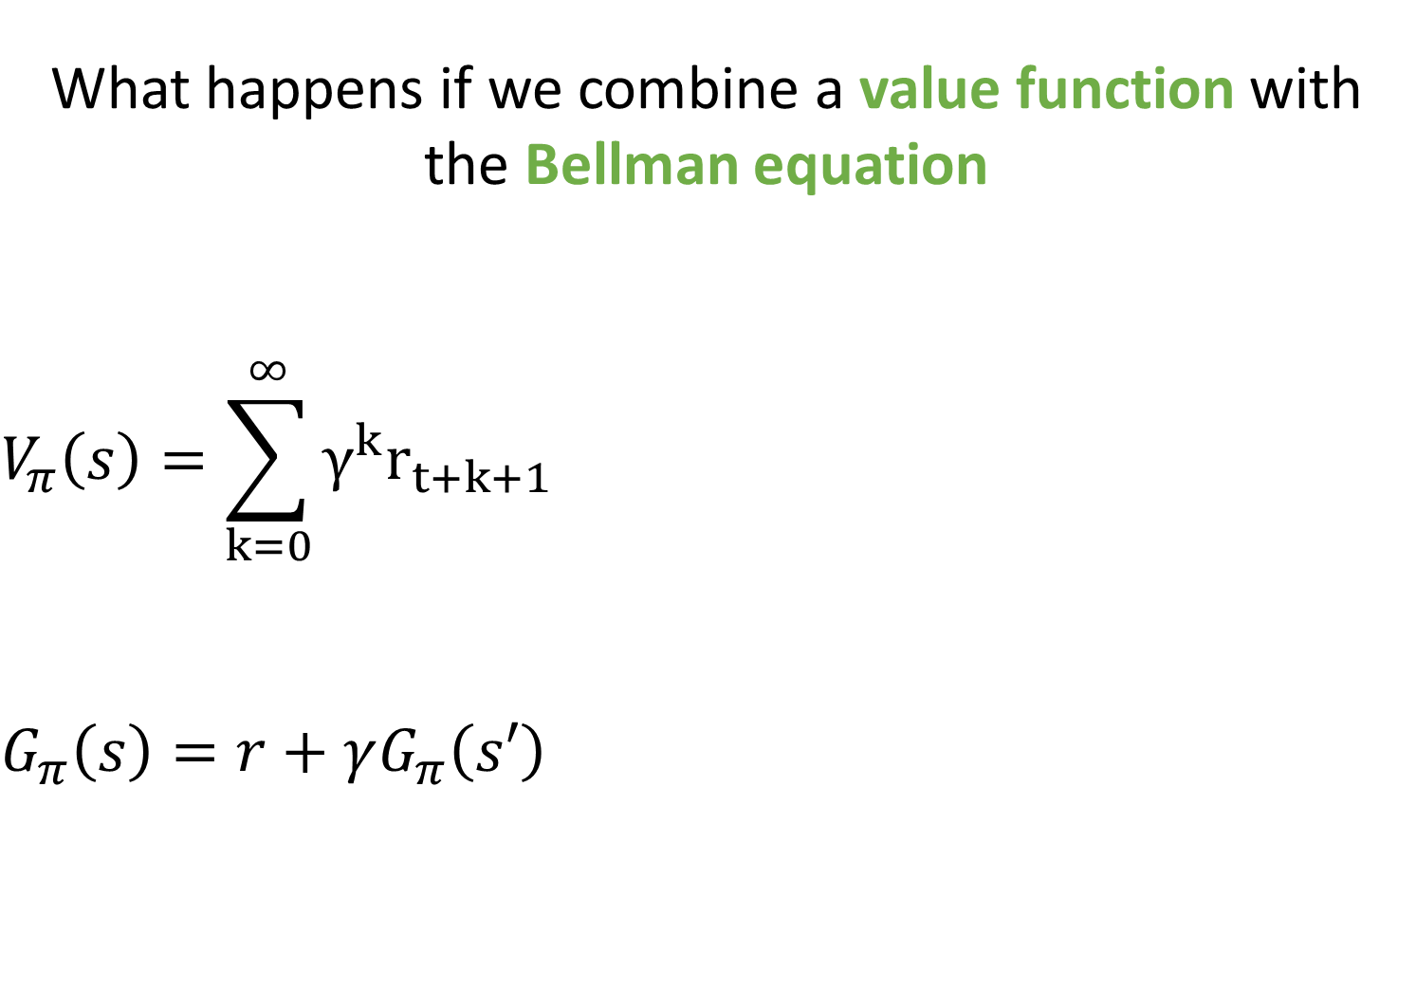
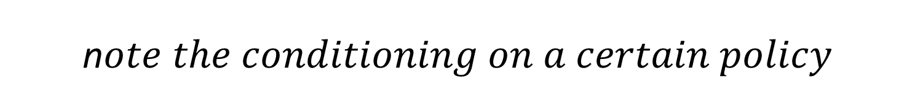
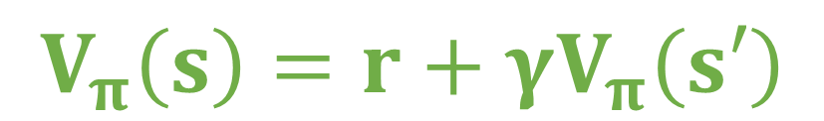
What happens if we combine a value function with the Bellman equation $$V_{π}\left(s\right)=\sum_{k=0}^{∞}{γ^{k}r_{t+k+1}}$$ $$G_{π}\left(s\right)=r+γG_{π}\left(s′\right)$$
$$V_{π}\left(s\right)=r+γV_{π}\left(s′\right)$$
n$ote the conditioning on a certain policy$

Slide 70
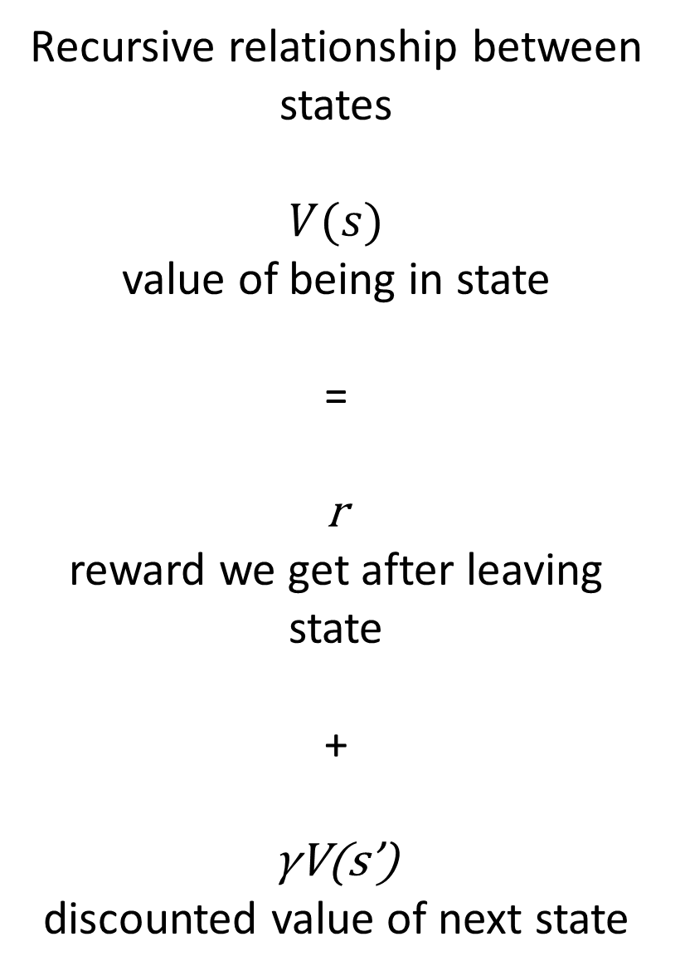
Recursive relationship between states $$V(s)$$ value of being in state = r reward we get after leaving state + γV(s’) discounted value of next state
s
state
r
s’
next state

Slide 71
Why is the Bellman equation important?

Slide 72
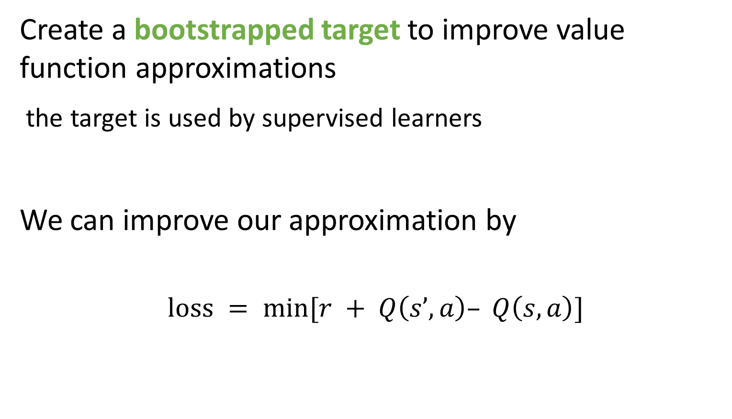
Bellman equation
Create a bootstrapped target to improve value function approximations
the target is used by supervised learners
We can improve our approximation by
$$\text{loss} = min⁡[r + Q\left(s’,a\right)– Q\left(s,a\right)]$$
target
current function
approximation

Slide 73
Bellman equation
Value function approximation is crucial for policy improvement
Policy approximation vs policy improvement
prediction vs control
Two problems
1 improving our approximation of the value function
2 improving our policy (ie our actions)

Slide 74
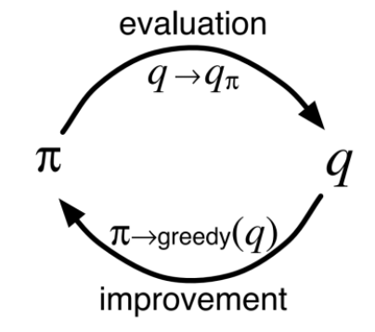
Approximation & improvement
Three different methods for approximation (there are more!)
dynamic programming
Monte Carlo
temporal difference
One method for policy improvement
change policy to favour the best action
Sutton & Barto

Slide 75
Approximation & improvement
This constant process of approximation & improvement is known as general policy iteration
Allows us to handle the non-stationary nature of reinforcement learning
non-stationary environment
learning process is non-stationary

Slide 76
three – value function methods
introduction to value functions & Bellman equation
value function approximation
dynamic programming

Slide 77
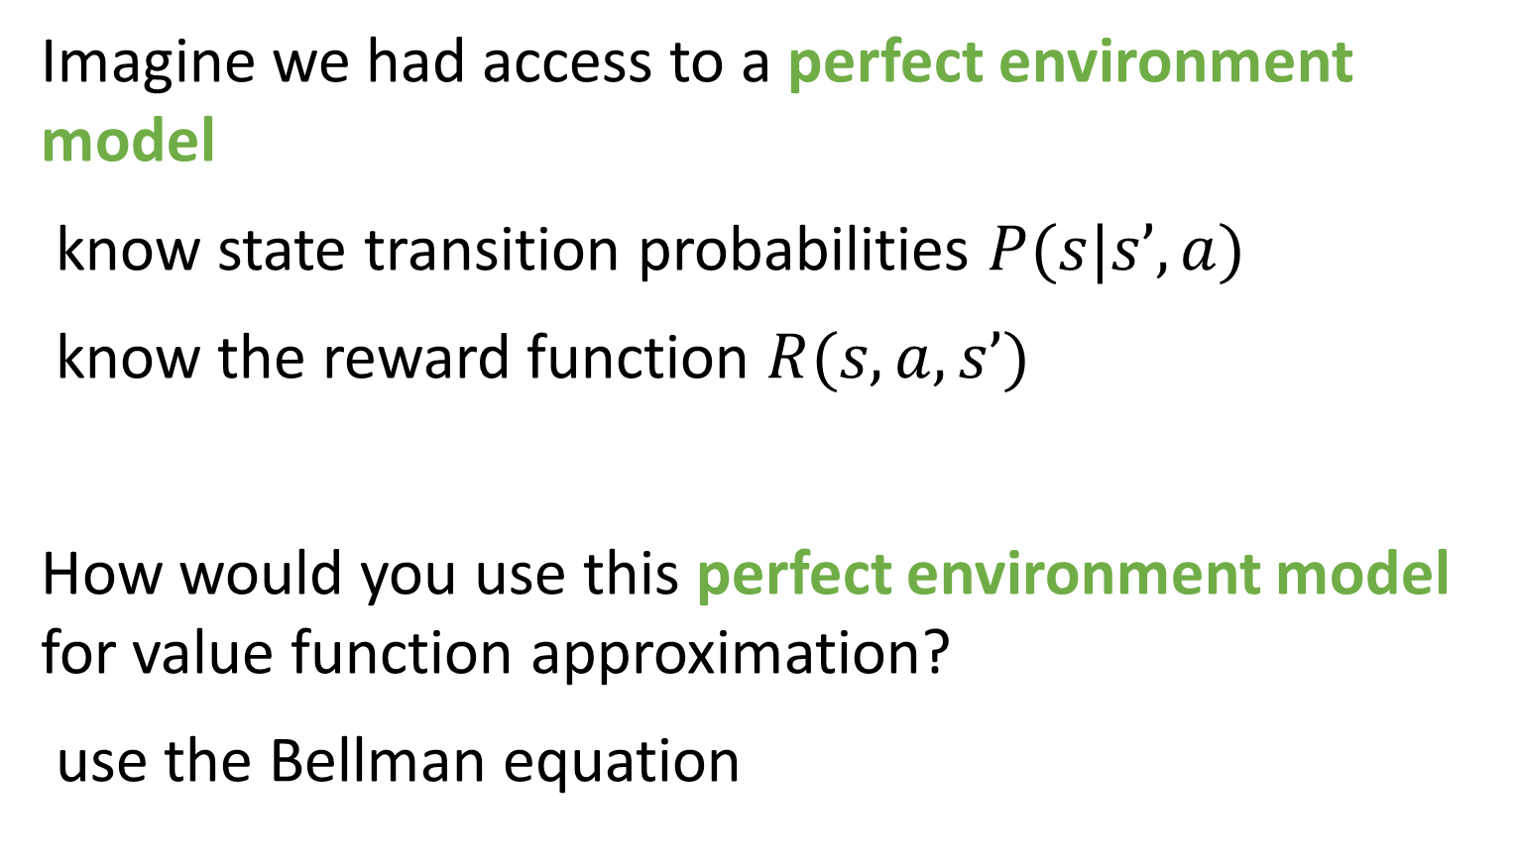
Dynamic programming
Imagine we had access to a perfect environment model
know state transition probabilities $P(s|s’, a)$
know the reward function $R(s, a, s’)$
How would you use this perfect environment model for value function approximation?
use the Bellman equation

Slide 78
Dynamic programming backup
s1
Random policy
Discount = γ = 0.9
r = 1
p = 50%
r = 2
p = 50%
s2
s3
r = 5
p = 100%
s4
The state transition probabilities p depend both on the environment & policy

Slide 79
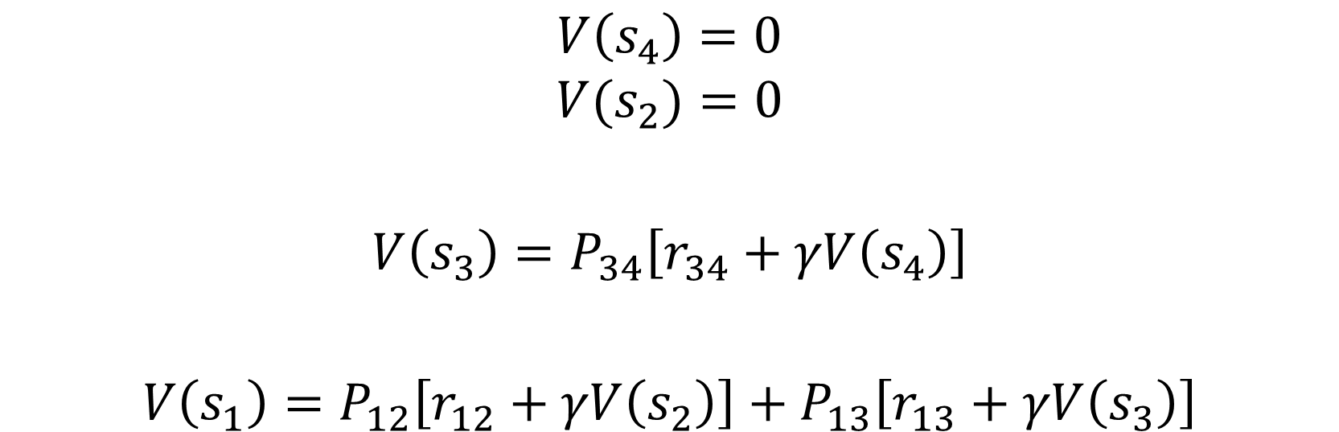
Dynamic programming backup
We can now perform iterative backups of the value of each state backwards in time
note – return for all terminal states are zero
$$V\left(s_{4}\right)=0$$
$$V(s_{2})=0$$
$$V\left(s_{3}\right)=P_{34}\left[r_{34}+γV\left(s_{4}\right)\right]$$
$$V\left(s_{1}\right)=P_{12}\left[r_{12}+γV\left(s_{2}\right)\right]+P_{13}\left[r_{13}+γV\left(s_{3}\right)\right]$$

Slide 80
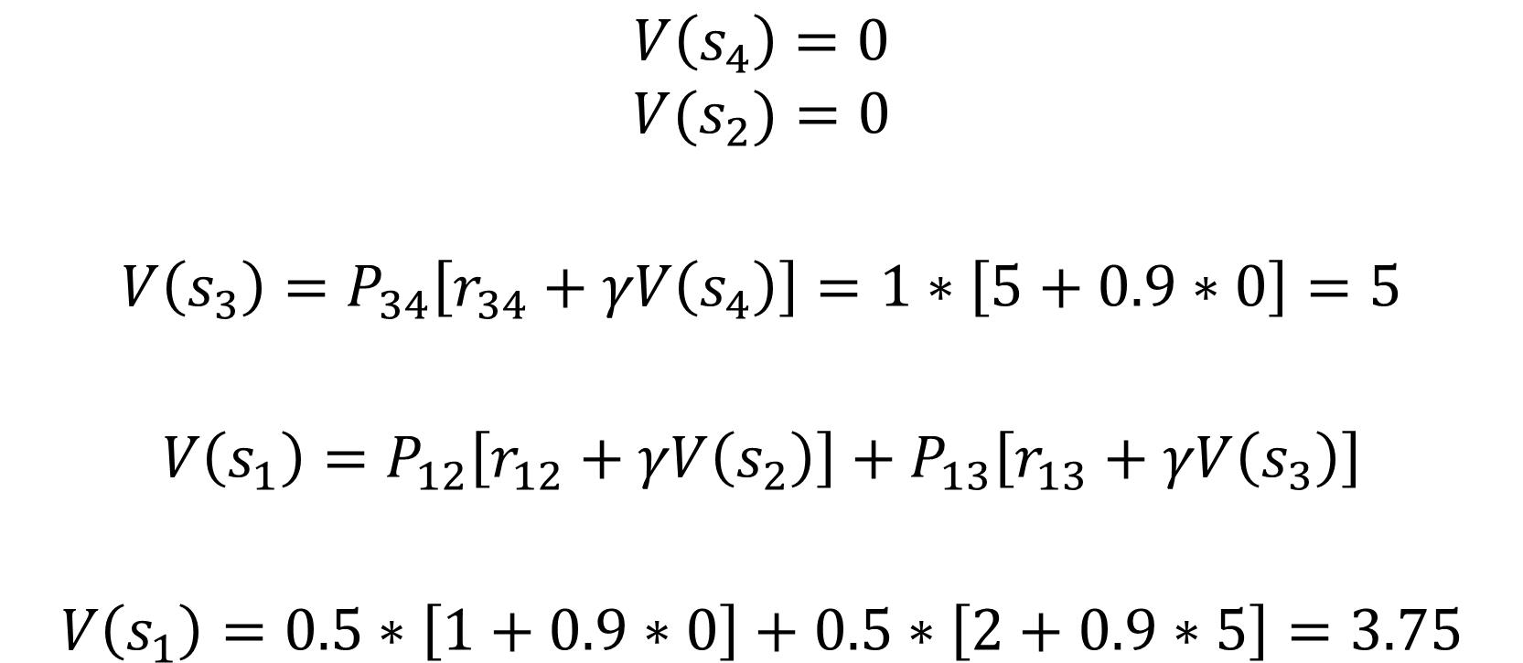
Dynamic programming backup
$$V\left(s_{4}\right)=0$$
$$V(s_{2})=0$$
$$V\left(s_{3}\right)=P_{34}\left[r_{34}+γV\left(s_{4}\right)\right]=1∗\left[5+0.9∗0\right]=5$$
$$V\left(s_{1}\right)=P_{12}\left[r_{12}+γV\left(s_{2}\right)\right]+P_{13}\left[r_{13}+γV\left(s_{3}\right)\right]$$
$$V\left(s_{1}\right)=0.5∗\left[1+0.9∗0\right]+0.5∗\left[2+0.9∗5\right]=3.75$$

Slide 81
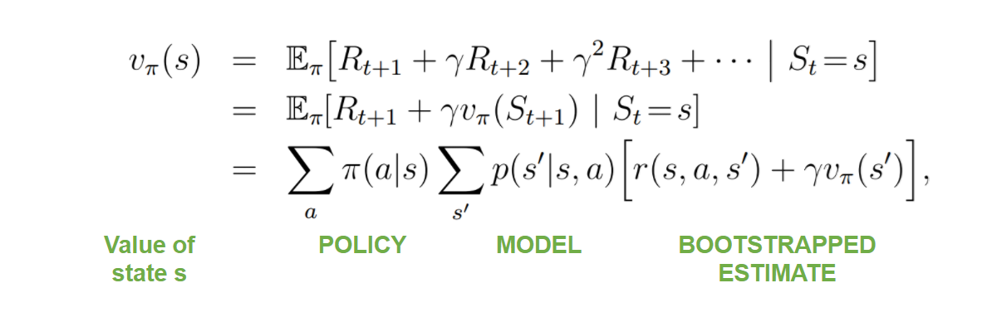
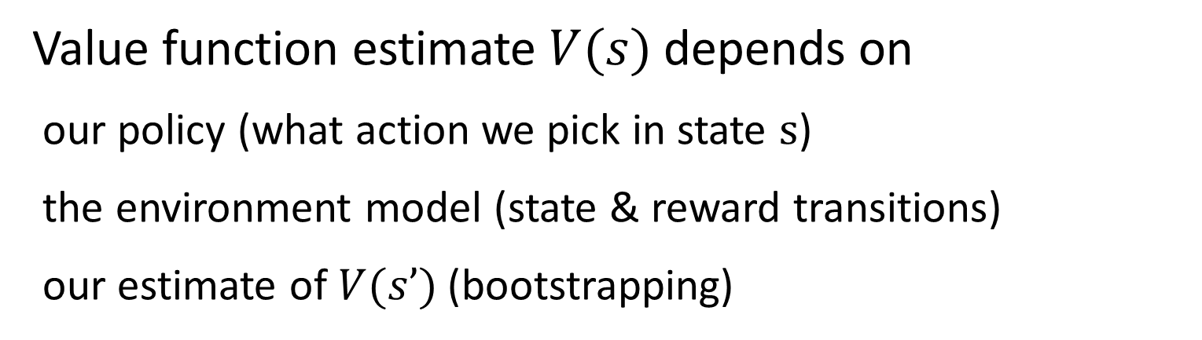
Dynamic programming
Sutton & Barto
Value function estimate $V(s)$depends on
our policy (what action we pick in state s)
the environment model (state & reward transitions)
our estimate of $V(s’)$(bootstrapping)

Slide 82
Dynamic programming
Sutton & Barto
V(s) depends on on the value of all possible s’
Even when P(s|s’, a)=0
Computationally expensive – every state is backed up by every other state

Slide 83
Dynamic programming
Requires a perfect environment model
we don’t learn from experience at all!
Bootstrapped
value function improves itself
Reliable convergence for tabular value function, finite, fully observed MDPs

Slide 84
three – value function methods
introduction to value functions & Bellman equation
value function approximation
dynamic programming
Monte Carlo

Slide 85
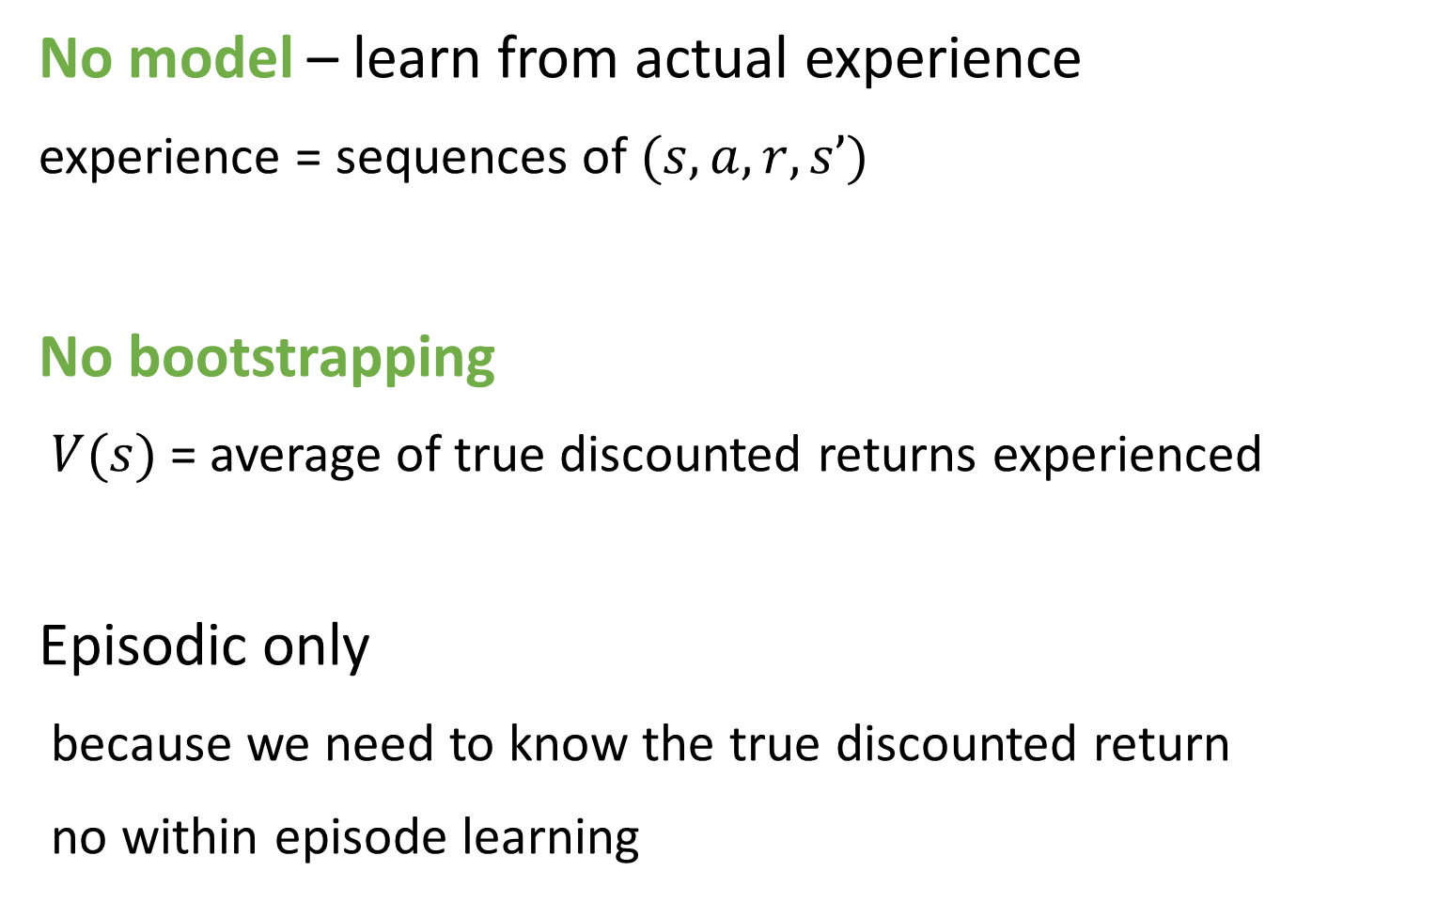
Monte Carlo
No model – learn from actual experience
experience = sequences of $(s, a, r, s’)$
No bootstrapping
$V(s)$= average of true discounted returns experienced
Episodic only
because we need to know the true discounted return
no within episode learning

Slide 86
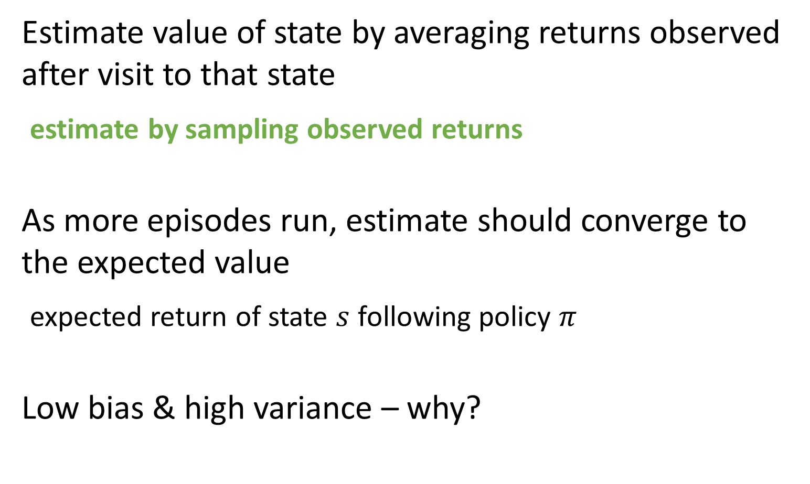
Monte Carlo
Estimate value of state by averaging returns observed after visit to that state
estimate by sampling observed returns
As more episodes run, estimate should converge to the expected value
expected return of state $s$ following policy $π$
Low bias & high variance – why?

Slide 87
Monte Carlo
High variance
we need to sample enough episodes for our averages to converge
can be a lot for stochastic or path dependent environments
Low bias
we are using actual experience
no chance for a bootstrapped function to mislead us

Slide 88
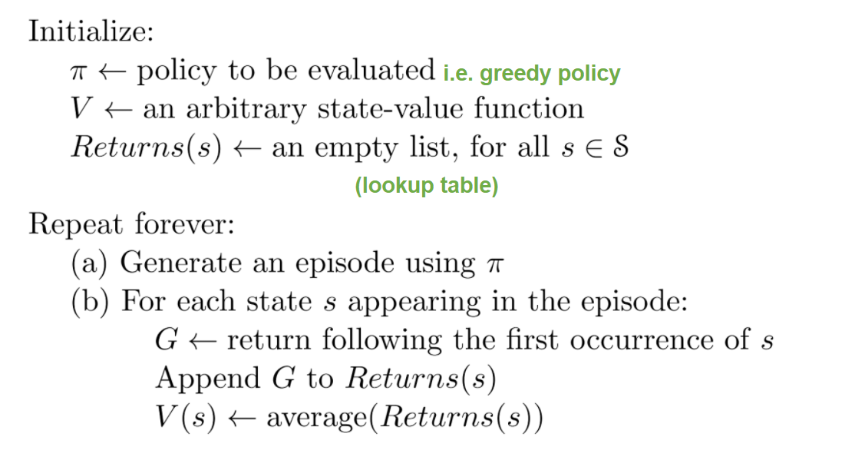
Monte Carlo
David Silver

Slide 89
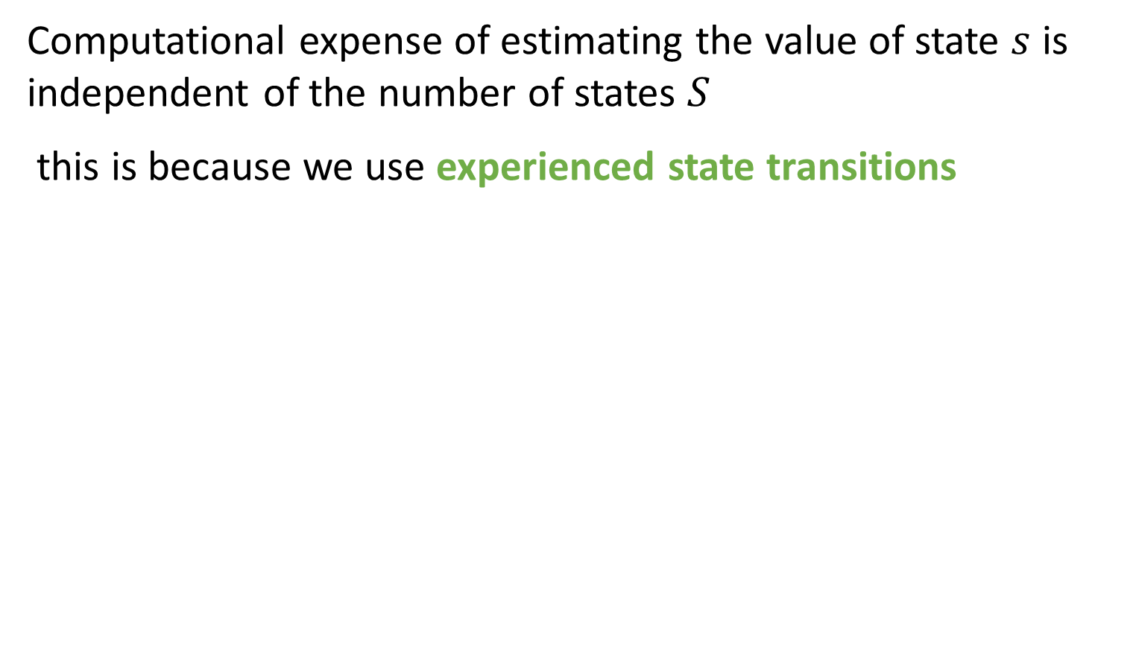
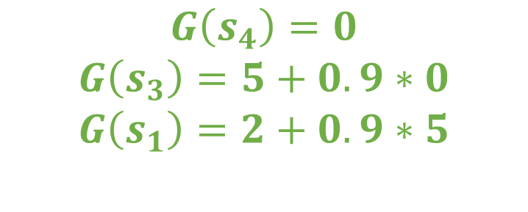
Interesting thing about Monte Carlo
Computational expense of estimating the value of state $s$ is independent of the number of states $S$
this is because we use experienced state transitions
s1
$$G\left(s_{4}\right)=0$$
$$G\left(s_{3}\right)=5+0.9∗0$$
$$G\left(s_{1}\right)=2+0.9∗5$$
r = 2
s2
s3
s4
r = 5

Slide 90
Monte Carlo
Learn from actual experience – no environment model
No bootstrapping – use true discounted returns
Episodic problems only – no learning online
High variance, low bias

Slide 91
three – value function methods
introduction to value functions & Bellman equation
value function approximation
dynamic programming
Monte Carlo
temporal difference

Slide 92
Temporal difference
Learn from actual experience – no environment model
Bootstrap – learn online
Episodic & non-episodic problems
Usually converges faster than Monte Carlo

Slide 93
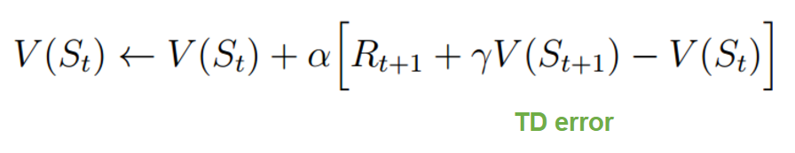
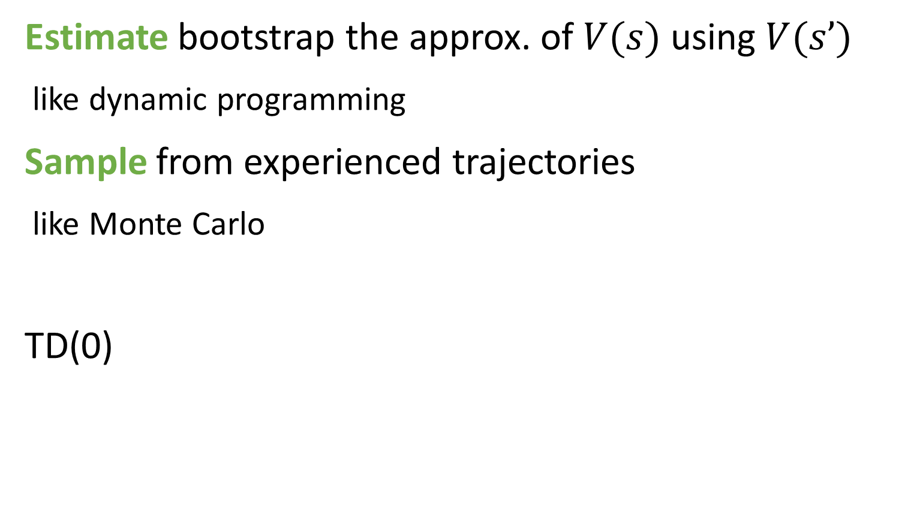
Temporal difference
Estimate bootstrap the approx. of $V(s)$ using $V(s’)$
like dynamic programming
Sample from experienced trajectories
like Monte Carlo
TD(0)

Slide 94
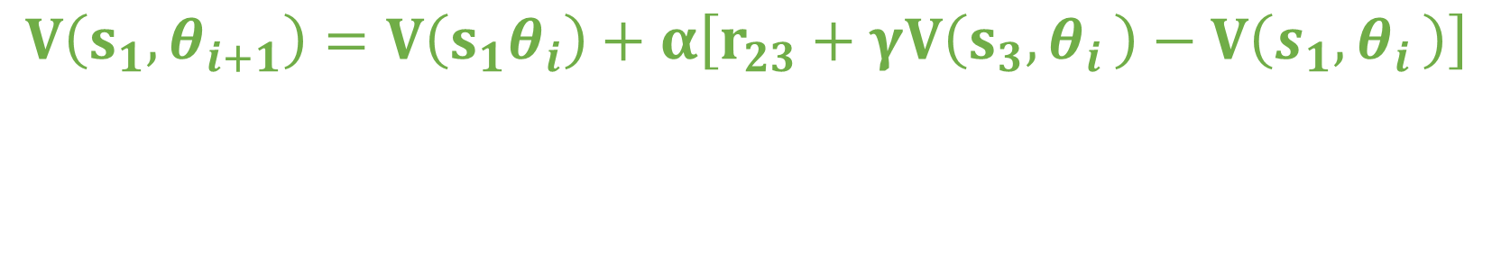
TD(0) backup
s1
r = 2
s2
s3
s4
r = 5
$$V\left(s_{1},θ_{i+1}\right)=V\left(s_{1}θ_{i}\right)+α\left[r_{23}+γV\left(s_{3}{,θ}_{i}\right)−V\left(s_{1}{,θ}_{i}\right)\right]$$
Bootstrapping
Using the experienced trajectory

Slide 95
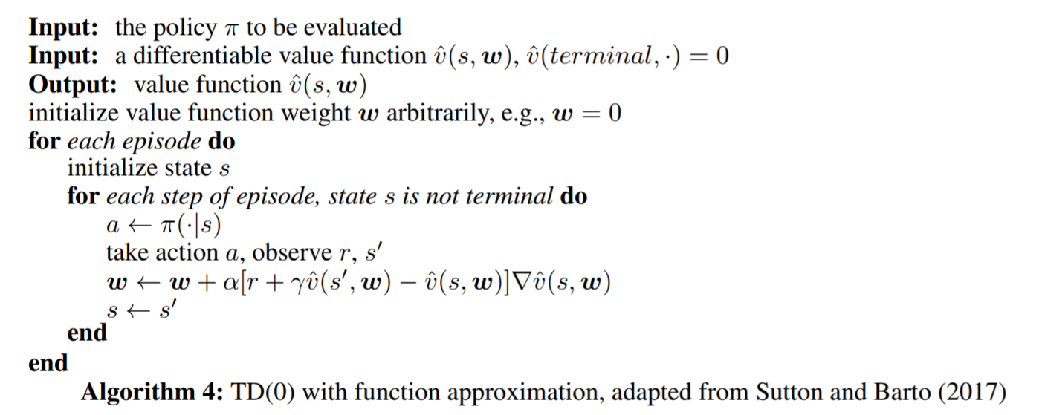
TD(0) algorithm
Ref = Li (2017)

Slide 96
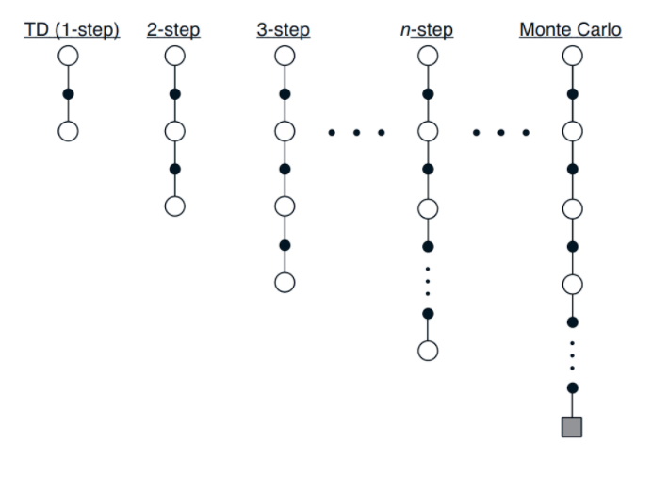
Linking together
Temporal difference & Monte Carlo are two extremes of the same scale
Bias-variance tradeoff
Further reading
TD(λ)
Eligibility traces
High bias
High variance
Sutton & Barto

Slide 97
break

Slide 98
recap – value function approximation
Dynamic programming
environment model, bootstraps
Monte Carlo
model free, samples actual returns, episodic only
Temporal difference
model free, bootstraps, samples actual experience

Slide 99
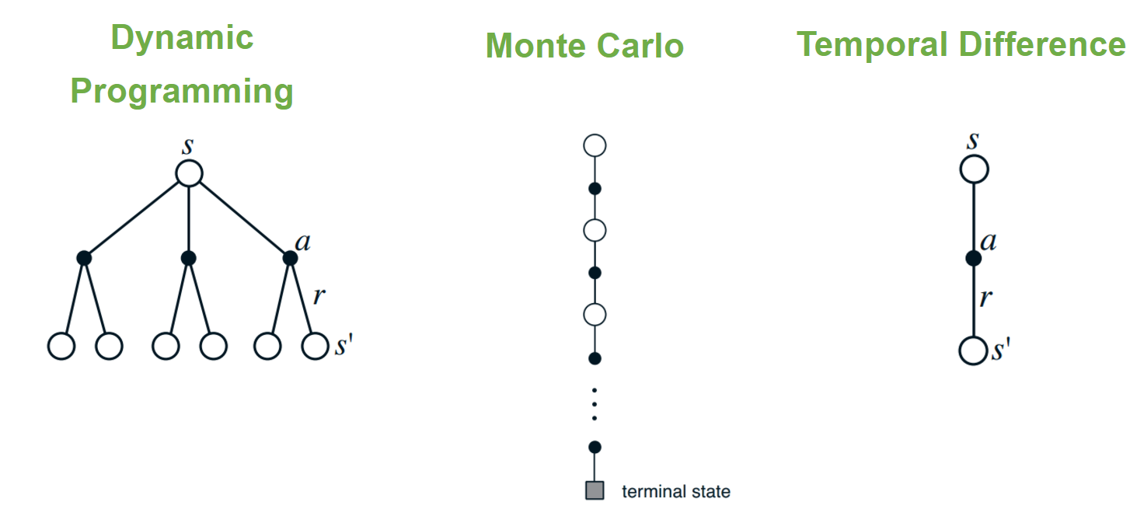
recap
Sutton & Barto

Slide 100
three – value functions
introduction to value functions & Bellman equation
value function approximation
dynamic programming
Monte Carlo
temporal difference
policy improvement & control
Q-Learning
DeepMind Atari work

Slide 101
Q-Learning

Slide 102
Q-Learning
Popular modern method for reinforcement learning
DeepMind innovations that got Q-Learning to work with neural network function approximators
experience replay
target networks
Both improve learning stability

Slide 103
Why Q-Learning?

Slide 104


$V(s)$ vs $Q(s, a)$
Both model future expected discounted return
Which is more useful?
$V(s)$tells us how good a state is
doesn’t tell us how to get there
$Q(s, a)$tells us how good an action is

Slide 105


SARSA & Q-Learning
Both are temporal difference methods
SARSA
on-policy
experienced state, action & reward
Q-Learning
off policy
experienced state & reward, max across all actions

Slide 106

SARSA & Q-Learning
Sutton & Barto

Slide 107

DQN Algorithm
ε-greedy action selection
experience replay
target network update
Minh et. al (2015)

Slide 108

Curse of dimensionality
Hits us twice in Q-Learning
Action selection
need to calculate $Q(s, a)$for each state action
select action with max Q
Training
need to calculate $Q(s′, a)$ for each action
to calculate max value of the next state $s′$

Slide 109

Maximization bias
$\text{argmax}$ allows Q-Learning to learn off-policy
to learn the optimal policy while following a sub-optimal policy
But the maximum is
aggressive
positively biased

Slide 110


Maximization bias
taking max of our estimates always gets us here
true value here
State where $Q(s,a) = 0$(for all possible $a$)
our estimates are distributed above & below 0
max(true value) = 0
max(estimated values) > 0

Slide 111

Double Q-Learning
Maintain two parameterized Q functions (A & B)
avg(A, B) to select actions
improve A by bootstrapping off B (or vice versa)

Slide 112
DeepMind Atari work

Slide 113


Slide 114


Slide 115
DeepMind Atari work
DQN = Deep Q-Network
Mnih et. al (2013) Playing Atari with Deep Reinforcement Learning
Mnih et. al (2015) Human-level control through deep reinforcement learning

Slide 116
Significance
End to end deep reinforcement learning
learning from high dimensional input
raw pixels & convolutional neural network
Ability to generalize
same algorithm, network structure and hyperparameters
intentionally sacrifice performance for ability to generalize
DeepMind purchased by Google for £400M in 2014

Slide 117

Reinforcement learning to play Atari
State = last four screens
allows information about movement
grey scale, cropped
Reward = game score
clipped to [-1,1]
reward counting
Actions = joystick buttons (a discrete action space)

Slide 118

Value function approximation

Slide 119

Visualizing Q

Slide 120



Q-Learning
$$r+γ\max_{a′}{Q(s^{′},a^{′};θ_{i}) −Q\left(s,a;θ_{i}\right)}$$
$$target$$
$$network$$
$$output$$
Can be hard to get working
correlations in the data
small updates to Q network may change the policy drastically
correlation between the target & network during training
But if it works, works really well
sample efficient

Slide 121
Deadly triad
1 - Off policy learning
to free behaviour policy from target policy
2 - Function approximation
scalability & generalization
3 - Bootstrapping
computational & data efficiency (trade variance for bias)
Combine to produce instability & divergence

Slide 122
Deadly triad
Unclear which of the three is root cause for instability
dynamic programming can diverge with function approximation
prediction can diverge (so it’s not exploration or control)
linear functions can be unstable (not non-linear functions)
It’s the combination of the three

Slide 123
Q-Learning
Discrete action spaces only
argmax across all possible actions
Deterministic policy
we always pick the best action
Two key techniques to improve stability
1 – experience replay (Lin 1993)
2 – target network

Slide 124


Experience replay
Sample
uniform
random
Replay buffer
$$[(s_{0}, a_{0}, r_{1},{s′}_{1}),$$
$$(s_{1}, a_{1}, r_{2},{s′}_{2}),$$
$$(s_{2}, a_{2}, r_{3},{s′}_{3}),$$
$$….$$
$$(s_{n}, a_{n}, r_{n+1},{s′}_{n+1})]$$
Training targets
$[Q\left(s_{0,}{ a}_{0}\right)=r_{1}+\underset{a}{γ max}{Q(s_{1},a)}$,
….,
$Q\left(s_{2,}{ a}_{2}\right)=r_{3}+\underset{a}{γ max}{Q(s_{3},a)}$]
Trained using batches of 32-64 random samples
Memory of last 1 million frames

Slide 125

Experience replay
Averaging of behavior distribution
more independent sampling
avoids the within trajectory correlation of$s$to $s’$
Data efficiency
learn from experience multiple times
Allows seeding with human expert experience

Slide 126
Biological inspiration
Hippocampus may support an experience replay process in the brain
Time compressed reactivation of recently experienced trajectories during offline periods
Provides a mechanism where value functions can be efficiently updated through interactions with the basal ganglia
Minh et. al (2015)

Slide 127

Prioritize training on experiences with high temporal difference error
Balance between greedy replay (on TD error) vs uniform random (like vanilla experience replay)
Faster learning

Slide 128



Target network
$$L_{i}\left(θ_{i}\right)= 𝔼_{(s,a,r,s^{′})\sim U(D)}\left[{r+γ\max_{a′}{Q(s^{′},a^{′};θ_{i}^{−}) −Q\left(s,a;θ_{i}\right)}}^{2}\right]$$
$$target$$
$$approx.$$
Second innovation behind DQN
Use a separate Q network to create the target
parameterizing with two sets of weights$θ$& $θ_{i}^{−}$
Update target network with new weights every 10k – 100k steps

Slide 129

Target network
Changing value of one action changes value of all actions & similar states
bigger networks less prone (less aliasing)
Stable training
no longer bootstrapping from the same function, but from an old & fixed version of $Q(s,a)$
Reduces the correlation between target and network output

Slide 130



$ε$-greedy exploration
$argmax[Q\left(s,a\right)]$is deterministic
Use $ε$-greedy exploration to explore state space
$ε$ decayed as learning improves greedy action selection

Slide 131

superhuman

Slide 132

Stability techniques
Minh – Deep Q-Networks – Deep RL Bootcamp 2017

Slide 133
Atari work timeline
2013 DQN – target network, experience replay
2015 Prioritized experience replay
2016 Double DQN (DDQN)
2016 Asynchronous Advantage Actor-Critic (A3C)
2017 Distributional Q-Learning

Slide 134
Vlad Mnih - 2017 Deep RL bootcamp
Emphasis on experimentation / grid searching
Use Huber loss instead of squared loss on Bellman error
Use RMSProp instead of vanilla SGD
Make sure your terminal state target = reward!

Slide 135


Slide 136
break

Slide 137
recap – Q-Learning
Off policy control - discrete action spaces only
Maximization bias – addressed by Double Q-Learning
Deadly triad – off policy, non-linear functions, bootstrapping
Experience replay – more iid, data efficiency
Target network – reduces correlation between target & network

Slide 138
four – policy gradients
motivations & introduction

Slide 139
Reinforcement learning
Value functions
Parameterize a value function
V_{π}(s, θ)
Q_{π}(s, a, θ)
Policy gradients
Parameterize a policy
π(s, θ)
Actor-Critic
Parameterize both a value function & policy

Slide 140

Policy gradients
Previously looked at generating a policy from a value function
argmax across the action space
Policy gradient methods parameterize a policy directly
$$π\left(\left.a_{t}\right|s_{t};θ\right)$$
probability of action $a_{t}$ given state $s_{t}$
a function parameterized by $θ$ (i.e. neural network weights)

Slide 141
John Schulman – Berkley, Open AI

Slide 142
Motivations for policy gradients
Stochastic policies
High dimensional or continuous spaces
Optimize what we care about (future discounted reward)
More stable convergence

Slide 143

Motivation - stochastic policies
Deterministic policy (always rock) is easily exploited
Stochastic policy also gets us exploration for free

Slide 144

Motivation – curse of dimensionality
Q-Learning requires a discrete action space to argmax across
policies can parametrize an action directly
Q-Learning suffers from the curse of dimensionality in high dimensional or continuous spaces
we take the argmax of $Q(s,a)$ across all possible actions
if we have a lot of possible actions = lots of computation

Slide 145
Motivations – optimize return directly
Value function methods optimize the accuracy of the value function in predicting future discounted return
this can be quite a complex problem to solve
can be simpler to just learn which action is correct
Policy methods optimize what we care about directly
changing weights according to the gradient that maximizes future reward

Slide 146



Motivations for policy gradients
$$Q(s, a1) = 10 min⁡$$
$$Q(s, a_{2}) = 5 min⁡$$
$$\underset{a}{argmax}{→ a_{2}}$$
vs
$$a_{2}\sim π(s)$$
Often the a policy can be more compact & simpler than using a value function

Slide 147
Policy gradients
Motivations
stochastic policies
high dimensional or continuous spaces
optimize what we care about directly
more stable convergence
exploration for free
Drawbacks
almost always converge to local optimum
sample efficiency

Slide 148
Policy gradients without equations
We have a parameterized policy
i.e. a neural network
How do we improve it?
change parameters to favour probable actions
change parameters to take actions that get more reward

Slide 149

Policy gradients with some equations
we can get the probability from our distribution
Imagine we have a policy $π\left(\left.a_{t}\right|s_{t};θ\right)$
probability distribution over actions (stochastic)
parameters $θ$
How do we improve it?
change parameters to favour probable actions
change parameters to take actions that get more reward

Slide 150
Policy gradients
Policy gradients are an optimization problem
One - pick (any) policy quality measure
i.e. average reward per step
Two - pick an optimization algorithm
i.e. gradient descent
change weights to maximize policy quality

Slide 151
Parameterizing policies - discrete
The type of policy you parameterize depends on the action space
discrete action space
output layer = softmax
[state]
[probabilities]

Slide 152

Parameterizing policies - continuous
The type of policy you parameterize depends on the action space
continuous action space
output layer = mean & stdev
[state]
Sample an action from the distribution
[mean, stdev]

Slide 153

Score function
gradient of the expectation of f(x)
expectation of the gradient of the log probability of x
*
f(x)
Log-likelihood ratio trick -> score function
$∇_{θ}𝔼\left[f\left(x\right)\right]=$ $𝔼\left[∇_{θ}\log{P(\left.x\right\rfloor }θ\right)f(x)]$

Slide 154

Score function
gradient of return wrt policy parameters
expectation for policy of the gradient of the policy wrt policy parameters
*
return
Log-likelihood ratio trick -> score function
$$∇_{θ}J\left(θ\right)={𝔼_{π_{θ}} [∇}_{θ}\log{π\left(\left.a_{t}\right|s_{t};θ\right)G_{t}]}$$

Slide 155

Training a policy
Gradient descent on expected return of the policy
Log-likelihood ratio trick -> score function
$∇_{θ}𝔼\left[f\left(x\right)\right]=$ $𝔼\left[∇_{θ}\log{P(\left.x\right\rfloor }θ\right)f(x)]$
$$∇_{θ}J\left(θ\right)={𝔼_{π_{θ}} [∇}_{θ}\log{π\left(\left.a_{t}\right|s_{t};θ\right)G_{t}]}$$
log(probability of action) * return
log(policy) * return

Slide 156
gradient
=
log(probability of action) * return

Slide 157
gradient
=
log(policy) * return

Slide 158

Policy gradient intuition
$$∇_{θ}\log{π\left(\left.a_{t}\right|s_{t};θ\right)G_{t}}$$
How probable was the action we picked $\log{π\left(\left.a_{t}\right|s_{t};θ\right)}$
want to reinforce actions we thought would be good
How good was that action $G_{t}$
reinforce actions that were actually good

Slide 159

Policy Gradient Theorem
$$Q^{π_{θ}} −not Q^{∗} !$$

Slide 160

Improving a policy
$$∇_{θ}\log{π\left(\left.a_{t}\right|s_{t};θ\right)G_{t}}$$
Score function constrains policy gradients to on-policy learning only
need to calculate the log probability of the action (on-policy)
Score function allows us to take expectations
because we can sample from our policy

Slide 161

Approximating return
We can use different methods to approximate the quality of an action
Monte Carlo REINFORCE = use actual returns
$$∇_{θ}\log{π\left(\left.a_{t}\right|s_{t};θ\right)G_{t}}$$
REINFORCE with a baseline
$$∇_{θ}\log{π\left(\left.a_{t}\right|s_{t};θ\right){(G}_{t}}−B(s_{t}))$$

Slide 162

REINFORCE with baseline
Li 2017

Slide 163

Approximating return
REINFORCE with a baseline
reduces variance without introducing bias
$$∇_{θ}\log{π\left(\left.a_{t}\right|s_{t};θ\right){(G}_{t}}−B(s_{t}))$$
A natural baseline is the value function
$$∇_{θ}\log{π\left(\left.a_{t}\right|s_{t};θ\right){(G}_{t}}−V(s_{t};w))$$
Gives rise to the concept of the advantage function
$$A\left(s_{t},a_{t}\right)=G_{t}−V\left(s_{t}\right)=Q\left(s_{t},a_{t}\right)−V(s_{t};w)$$

Slide 164
four – policy gradients
motivations & introduction
Actor-Critic

Slide 165

Reinforcement learning
Value functions
Parameterize a value function
$Vπ(s, θ)$
$Qπ(s, a, θ)$
Policy gradients
Parameterize a policy
$π(s, θ)$
Actor-Critic
Parameterize both a value function & policy
$Vπ(s, θ)$
$Qπ(s, a, θ)$
$π(s, θ)$

Slide 166
Actor-Critic
Parameterize
policy = actor
value function = critic
Actor updates the policy parameters in the direction suggested by the critic

Slide 167

Sutton & Barto

Slide 168

Actor-Critic algorithm
Li 2017

Slide 169
A3C
Asynchronous Advantage Actor-Critic (A3C)
has obsoleted DQN as state of the art
works in continuous action spaces
Asynchronous
multiple agents learning separately
experience of each agent is independent of other agents

Slide 170

A3C
Advantage
advantage function
$$A\left(s_{t},a_{t}\right)=G_{t}−V\left(s_{t}\right)=Q\left(s_{t},a_{t}\right)−V(s_{t};w)$$
Agent can determine how much better an action is than the average action
average for the policy being followed

Slide 171

A3C
https://medium.com/emergent-future/simple-reinforcement-learning-with-tensorflow-part-8-asynchronous-actor-critic-agents-a3c-c88f72a5e9f2

Slide 172
break

Slide 173
recap – policy gradients

Slide 174

five – AlphaGo

Slide 175

AlphaGo
2015
first machine to beat human professional (Lee Sedol)
2017
beat no. 1 ranked player Ke Jie

Slide 176


Slide 177

IBM Deep Blue
First defeat of world chess champion by a machine in 1997

Slide 178
Deep Blue vs AlphaGo
Deep Blue was handcrafted
programmers & chess grandmasters
AlphaGo learnt
human moves & self play
AlphaGo evaluated fewer positions
width policy network select states more intelligently
depth value function evaluate states more precisely

Slide 179

Why Go?
Long held as the most challenging classic game for artificial intelligence
massive search space - more positions than atoms in universe
difficult to evaluate positions & moves
sparse & delayed reward

Slide 180

AlphaGo
AlphaGo works to reduce both the width and depth of search
width by sampling high probability actions from policy
depth through position evaluation using $V(s)$

Slide 181

Components of the AlphaGo agent
Three policy networks $π(s)$
fast rollout policy network – linear function
supervised learning policy – 13 layer convolutional NN
reinforcement learning policy – 13 layer convolutional NN
One value function $V(s)$
convolutional neural network
Combined together using Monte Carlo tree search

Slide 182
Components of the AlphaGo agent
1 – train fast & supervised policy networks
predicting human moves
2 – train reinforcement learning policy network
initialize using supervised network weights
self play (align gradient towards winning)
3 – train value function
use data generated during self play

Slide 183

Learning

Slide 184
Monte Carlo Tree Search
Analyse most promising next moves in detail
Planning algorithm
simulated (not actual experience)
Roll out to end of game
the actual simulated Monte Carlo return

Slide 185
Monte Carlo Tree Search
1 - pick a state to investigate further
using measures of state value & visit statistics
2 - rollout down from this state
use linear fast rollout policy
3 - repeat

Slide 186


http://www.cameronius.com/research/mcts/about/index.html

Slide 187

Monte Carlo Tree Search

Slide 188
AlphaGo, in context – Andrej Karpathy
Convenient properties of Go
fully deterministic
fully observed
discrete action space
access to perfect simulator
relatively short episodes
evaluation is clear
huge datasets of human play
energy consumption (human ≈ 50 W) 1080 ti = 250 W
https://medium.com/@karpathy/alphago-in-context-c47718cb95a5

Slide 189


DeepMind AlphaGo AMA

Slide 190



DeepMind AlphaGo AMA
https://www.reddit.com/r/MachineLearning/comments/76xjb5/ama_we_are_david_silver_and_julian_schrittwieser/

Slide 191
Brief timeline
October 2015 beat European Go champion 5-0
March 2016 beat Lee Sedol (Federer of Go) 4-1
May 2017 beat Ke Jie (world no. 1) 3-0
superhuman
October 2017 AlphaGo Zero beats AlphaGo 100-0

Slide 192
break

Slide 193
six – practical concerns

Slide 194
Key questions
What is the action space
what can the agent choose between
What is the reward
Is it a complex problem
path dependency

Slide 195
Formulating action spaces
Continuous or discrete action space
determines which algorithms can be used
Constant vs variable action space
Important to be as computationally efficient as possible in creating state action combinations
i.e. for learning & training in Q-Learning

Slide 196
Reward scaling
Scaling of network inputs and targets is required
supervised techniques are sensitive to scale
normalization (scale to range 0.0 to 1.0)
standardization (scale to mean=0, stdev=1)
True mean, min & max of value function not known
this is a reinforcement learning specific problem
supervised learning you can estimate these from training data

Slide 197

DQN clips rewards to [-1,+1]
this becomes reward counting
changes agent behavior

Slide 198
Learning values across many orders of magnitude
DQN clips rewards to [-1,+1]
this becomes reward counting
changes agent behavior
2016 DeepMind proposed adaptively normalizing targets
helps agent to generalize across games
helps with non-stationary problems

Slide 199
Learning curves
Evaluate Q(s,a) on a set of holdout states

Slide 200

Silly mistakes I’ve made so far
Monte Carlo policy gradient
using experience replay
shuffling the samples when training
using $ε$-greedy policy
Not thinking about discount factor enough

Slide 201
Hyperparameters
Monte Carlo policy gradient
learning rate
DQN
epsilon – exploration
update target network

Slide 202

John Schulman – Berkley Deep RL Bootcamp 2017

Slide 203
John Schulman advice
Quick experiments on small test problems
Interpret & visualize learning process
state visitation, value functions
Make it easier to get learning to happen (initially)
input features, reward function design
Always use multiple random seeds

Slide 204
John Schulman advice
Standardize data
if observations in unknown range, estimate running average mean & stdev
Rescale rewards - but don’t shift mean
Standardize prediction targets (i.e. value functions) the same way

Slide 205
John Schulman advice
Batch size matters
Policy gradient methods - initialization matters
determines initial state visitation
DQN converges slowly

Slide 206


seven – beyond the expectation

Slide 207

Beyond the expectation
All the reinforcement learning today we have seen is about the expectation (mean expected return)
$$Q\left(s,a\right)=𝔼[G_{t}]=𝔼[r+γQ\left(s^{′},a\right)]$$
In 2017 DeepMind introduced the idea of the value distribution
State of the art results on Atari

Slide 208

Beyond the expectation
$$Q(s, a1) = 10 min⁡$$
$$Q(s, a_{2}) = 5 min⁡$$
Expectation for uniform random policy = 7.5 min!
The expectation of 7.5 min will never occur in reality!

Slide 209

Bellemare et. al 2017

Slide 210


Beyond the expectation

Slide 211

seven – inverse RL

Slide 212

Chelsea Finn – Berkley Deep RL Bootcamp 2017

Slide 213

Chelsea Finn – Berkley Deep RL Bootcamp 2017

Slide 214
thank you
Adam Green adgefficiency.com
adam.green@adgefficiency.com

